Slide 1
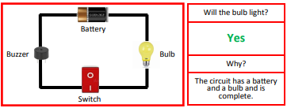
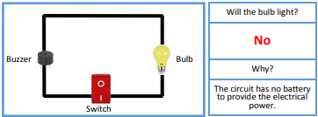
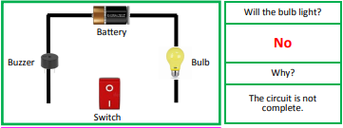
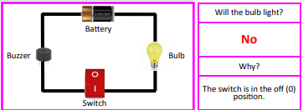
Science Knowledge Organiser
Electricity
Year 4
Diagrams and Symbols
Key Vocabulary | Definition
electricity | The flow of an electric current or charge through a material.
generate | To make or produce.
renewable | A source of electricity that will not run out.
non-renewable | This source of energy will eventually run out.
appliances | A piece of equipment or device designed to perform a particular job, such as a washing machine or mobile phone.
battery | A device that stores electrical energy as a chemical.
circuit | A pathway that electricity can flow around. It includes wires and a power supply and may include bulbs, switches or buzzers.
electrons | Small particles with an electric charge.
Will the bulb light in the circuit?
What? (Key Knowledge)
Lightning and static electricity are examples of electricity occurring naturally but for us to use electricity to power appliances, we need to make it.
A conductor of electricity is a material that is made up of free electrons which can be made to move in one direction, creating an electric current. Electrical insulators have no free electrons and so no electric current can be made.
Electricity can only flow around a complete circuit that has no gaps. There must be wires connected to both the positive and negative end of the power supply/battery.
Switches can be used to open or close the circuit. When off, a switch ‘breaks’ the circuit to stop the flow of electrons. When the switch is on, the circuit is complete and the electrons are able to flow around the circuit.
Mains electricity: power stations send an electric charge through wires to transformers and pylons. Then, underground wires carry the electricity into our homes via wires in the walls and out through plug sockets.
Battery electricity: batteries store chemicals which produce an electric current. Eventually, even rechargeable batteries will stop producing an electric current.

