Slide 1
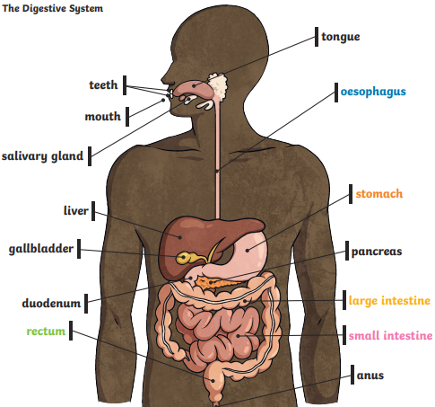
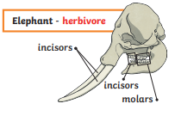
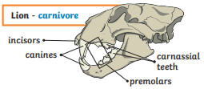
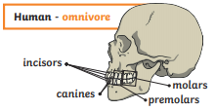
Science Knowledge Organiser
Animals, including humans
Year 4
Diagrams and Symbols
Key Vocabulary | Definition
digest | Break down food so it can be used by the body.
small intestine | Part of the intestine where nutrients are absorbed into the body.
large intestine | Part of the intestine where water is absorbed from remaining waste food. Stools are formed in the large intestine.
producer | Food chains start with a producer (usually a green plant or algae).
consumer | Consumers get their food by eating plants or other animals.
predator | Animals which eat other animals are called predators.
prey | Animals that are eaten by other animals.
molars | Back teeth for crushing and grinding food.
canines | Pointed teeth that tear and rip food.
incisors | Front teeth for snipping and cutting food.
What? (Key Knowledge)
Digestion is the way the body breaks down food to give the body energy.
The main parts of the digestive system are: mouth, tongue, pharynx, oesophagus, liver, stomach, gallbladder, pancreas, large intestine, small intestine.
There are 4 different types of teeth: incisors, canines, pre-molars, molars
Teeth facts | Teeth grow in babies when they are about 6 months old 20 teeth grow by the time you are about 2.5 years old From about age 6 you start to lose teeth till about the age 12 These teeth are replaced by 32 permanent teeth

