Slide 1
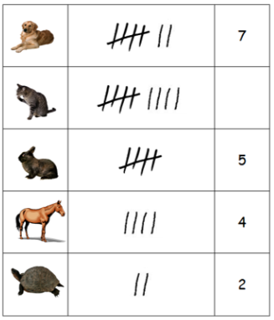
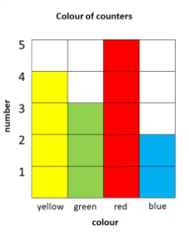
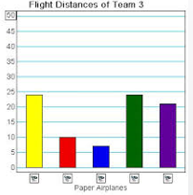
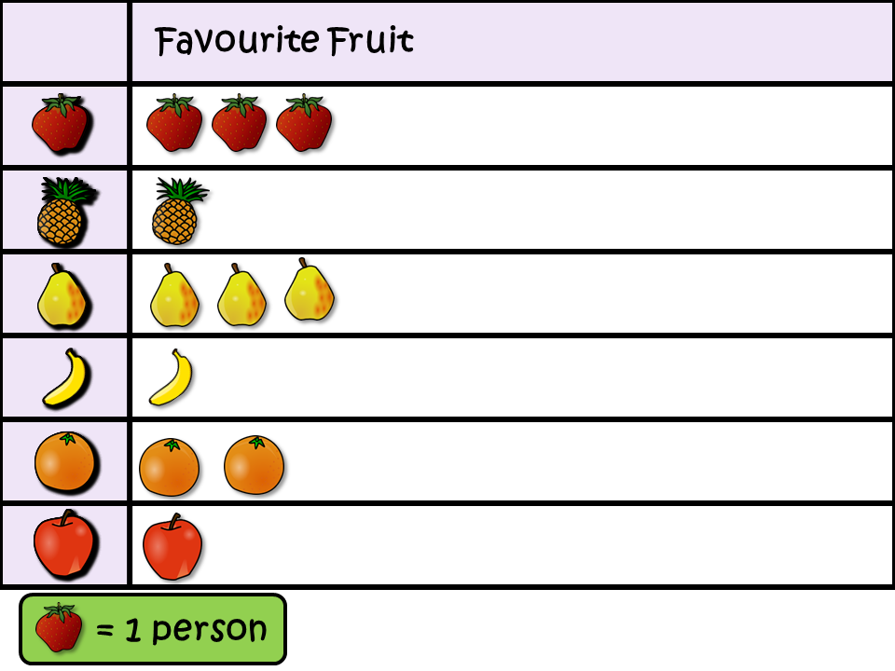
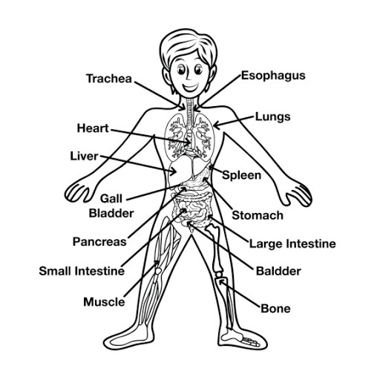
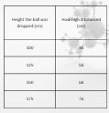
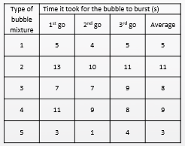

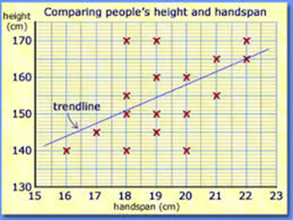
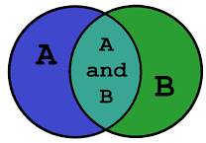
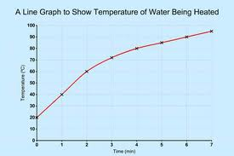
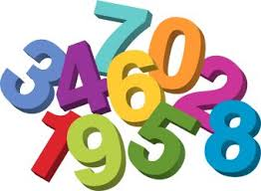



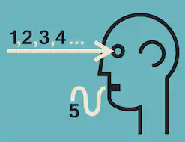



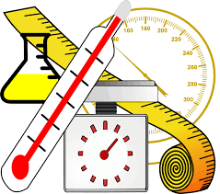


Science Knowledge Organiser
Working Scientifically
Year 6
Recording Data
Labelled diagram
Tables
Bar chart
Pictogram
Block graph
Sorting diagram
Line
graph
Scatter
graph
Planning and Communication and Sources
Enquiring and Testing and Obtaining and Presenting Evidence
Key Vocabulary | Definition
scale | A series of marks to show amounts or for measuring.
quantitative data | Information that is counted or measured.
anomalous | Unusual or different from the rest
interpretation | Explain the meaning of and understand something.
experimental evidence | Things found to be true from the result of an experiment.
experiment | A carefully planned test used to discover something unknown.
apparatus | A set of equipment used in an experiment.
method | The way the experiment is done.
conclusion | Things that can be worked out from the results of an experiment.
Describe evidence for a scientific idea.
Choose scales for graphs to show data.
Communicate quantitative data using scientific language.
Explain how interpretation leads to new ideas.
x
Identify measurements and observations that don’t fit the pattern.
Begin to explain anomalous data.
Use scientific knowledge to find a way of investigating something.
Observing and Recording
Considering Evidence and Evaluating
Measure amounts accurately using fine scale divisions e.g. on a thermometer.
Make well thought out suggestions to improve methods.
Select and use information.
Explain conclusions, showing understanding of scientific ideas.
Show how interpreting experimental evidence leads to new ideas.
Make enough observations and measurements for the task..

