Slide 1
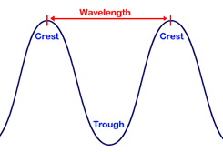
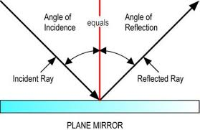
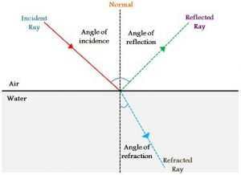
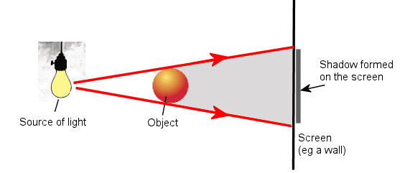
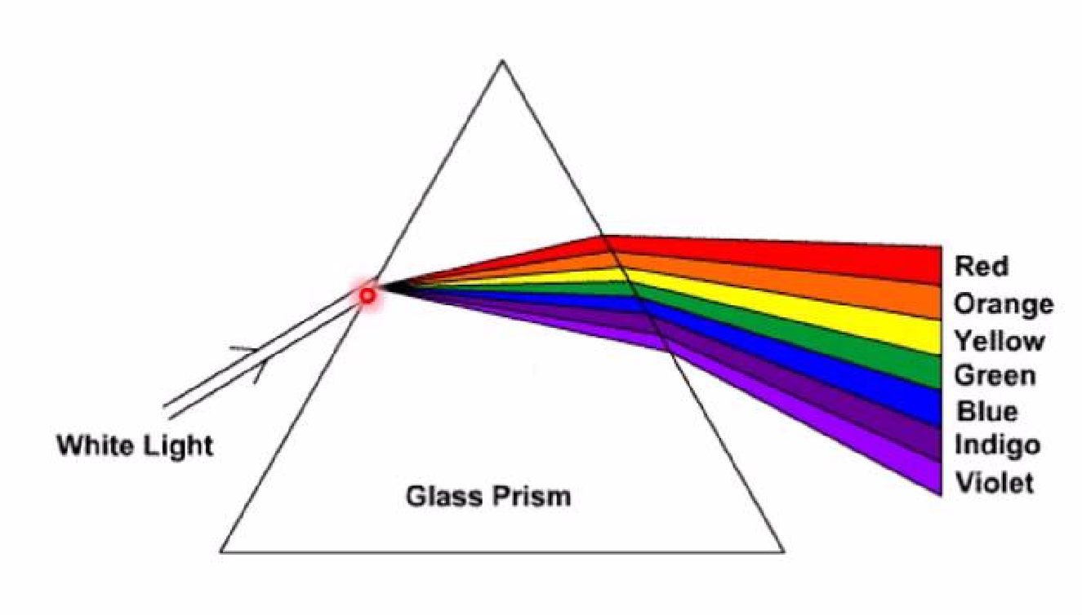
Science Knowledge Organiser
Light
Year 6
Diagrams and Symbols
Key Vocabulary | Definition
light | A form of energy that travels in a wave from a source.
light source | An object that makes its own light.
reflection | When light bounces off a surface, changing the direction of a ray of light.
incident ray | A ray of light that hits a surface.
reflected ray | A ray of light that has bounced back after hitting a surface
refraction | When light bends as it passes from one medium to another.
visible spectrum | Light that is visible to the human eye. It is made up from seven colours.
prism | A prism is a solid 3D shape with flat sides. The two ends are an equal shape and size.
shadow | An area of darkness where light has been blocked.
transparent | Describes objects that let light travel through them easily, meaning you can see through the object.
translucent | Describes objects that let some light through, but scatters the light so we can’t see through them properly.
opaque | Describes objects that do not let any light pass through them.
Reflection
What? (Key Knowledge)
We need light to be able to see things. Light waves travel out from sources of light in straight lines. These lines are often called rays or beams of light.
Light travels as a wave. But unlike waves of water or sound waves, it does not need a medium to travel through. This means light can travel through a vacuum - a completely airless space.
The law of reflection states that the angle of incidence is equal to the angle of reflection. The angle of reflection is the angle between the normal line and the reflected ray light. The angle of incidence is the angle between the normal line and the incident ray of light.
A shadow is always the same shape as the object that casts it. A shadow is formed when an opaque object blocks light.
Shadows can be elongated or shortened depending on the angle of the light source.
The colours of the light spectrum are red, orange, yellow, green, blue, indigo and violet. A spectrum can be created when light is shone through a transparent prism.
Refraction
Shadows
Light Spectrum

