Slide 1
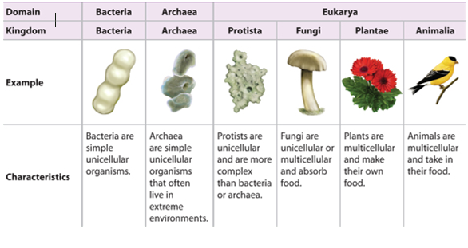
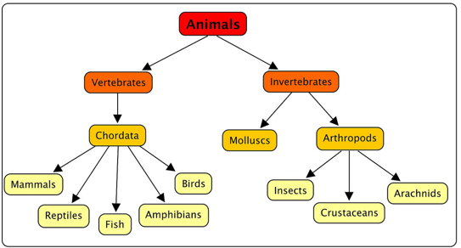
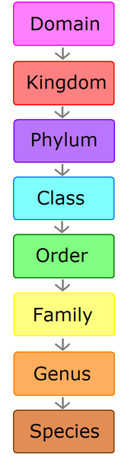
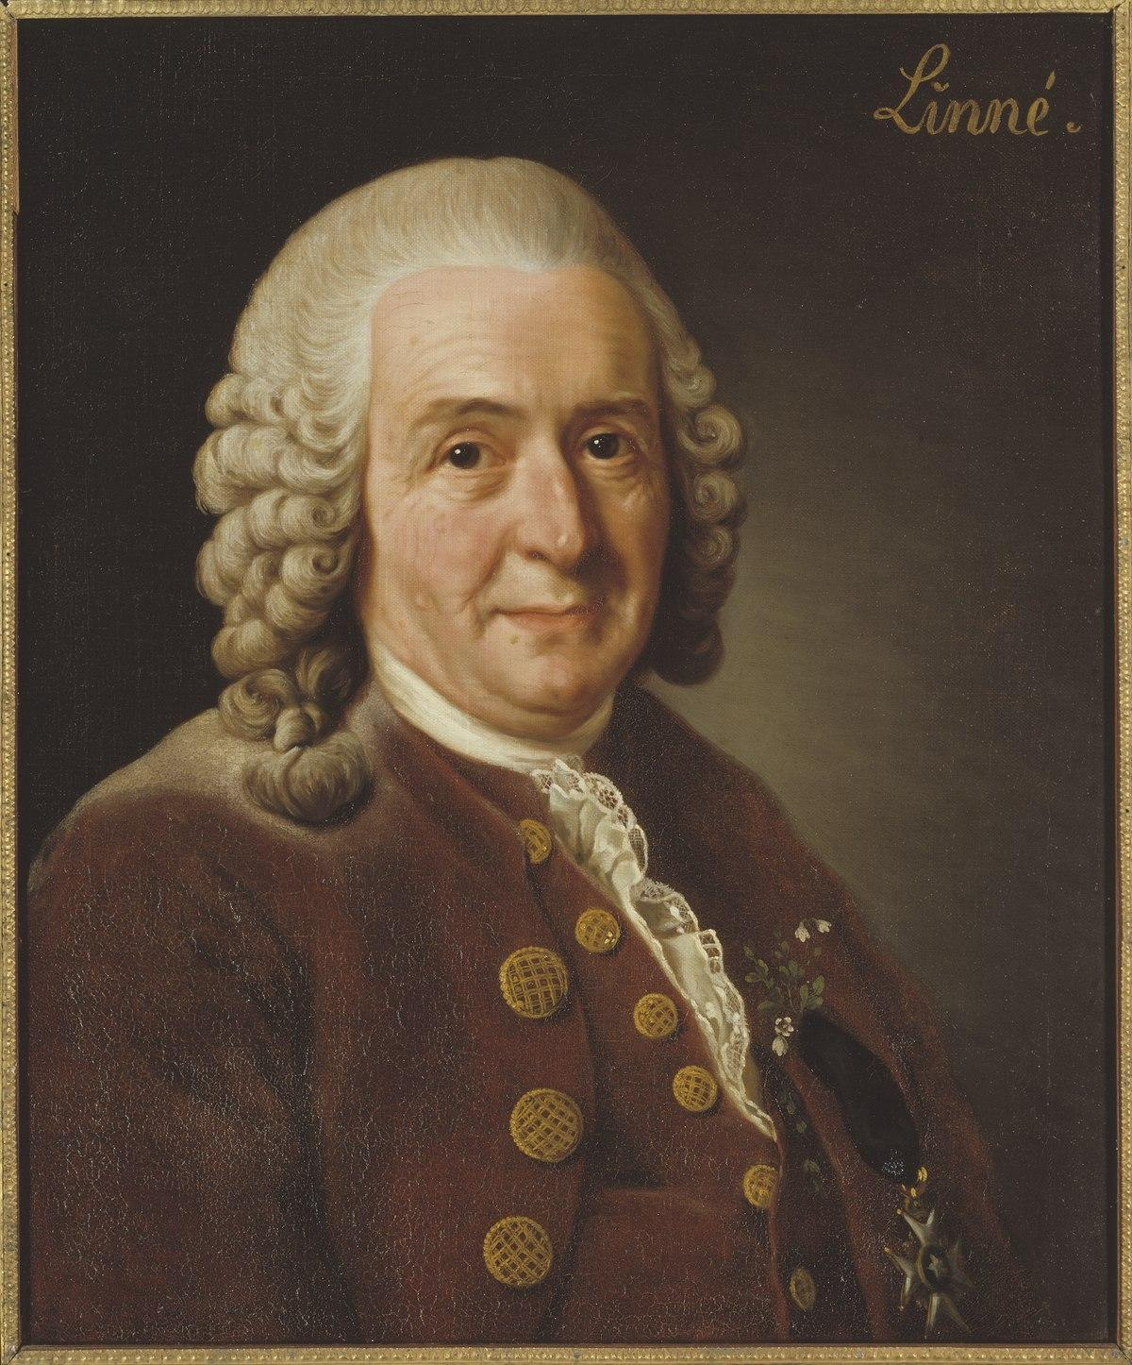
Science Knowledge Organiser
Living things and their habitats
Year 6
Diagrams and Symbols
Key Vocabulary | Definition
classification | The arrangement of organisms into groups based on their similarities and evolutionary relationships.
organism | An individual animal, plant or single-celled life form.
genus | A group of related organisms. Their similarities may not be obvious.
species | A group of closely related organisms that are similar and usually capable of producing offspring.
taxonomy | The science of naming, identifying and classifying organisms.
microorganism | An organism that is microscopic and cannot be seen with the naked eye.
algae | A single or multi cellular organism that has no roots, stem or leaves and is usually found in water.
fungi | A classification of organisms such as yeast, mould and mushrooms.
bacteria | Microorganisms that are everywhere around us . They can be helpful or harmful.
virus | A small infectious agent that can only replicate inside a living organism.
What? (Key Knowledge)
The 7 features of living things are: Movement, Respiration, Sensitivity, Growth, Reproduction, Excretion, Nutrition M-R-S G-R-E-N
Carl Linnaeus 1707-1778 | A Swedish scientist known as the “father of taxonomy”
Linnaeus created the “binomial nomenclature”. This is a way of classifying animals and plants (taxonomy)
Linnaeus gave each organism a 2 part Latin scientific name based on their genus and species. E.g panthera leo (lion)- genus panthera, species leo panthera tigris (tiger)- genus panthera, species tigris.
Microorganisms are very tiny living things that can only be seen using a microscope.
Viruses are neither living nor non-living. They can only replicate when inside a living organism.
Key Figures and Scientists
Carl Linnaeus

