Slide 1
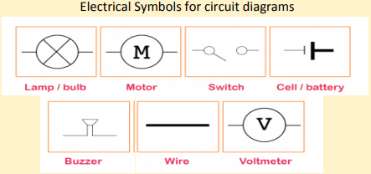
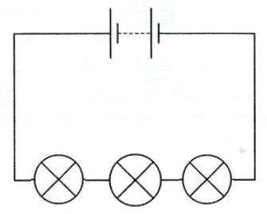
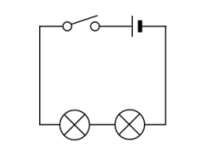
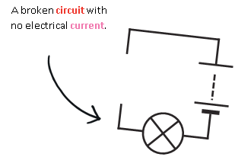
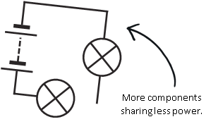
Science Knowledge Organiser
Electricity
Year 6
Diagrams and Symbols
Key Vocabulary | Definition
circuit | A path that an electrical current can flow around.
symbol | A visual picture that stands for something else.
cell/battery | A device that stores energy as a chemical until it is needed. A cell is a single unit. A battery is a collection of cells.
component | .Part of a circuit. A bulb is a component in a circuit.
current | The flow of electrons, measured in amps
amps | How electric current is measured.
voltage | The force that makes the electric current move through the wires. The greater the voltage, the more current will flow.
resistance | The difficulty that the electric current has when flowing around a circuit.
electrons | Very small particles that travel around an electrical circuit.
What? (Key Knowledge)
Series Circuit - A circuit that has only one route for the current to take. If more bulbs or buzzers are added, the power has to be shared and so they will be dimmer or quieter. If just one part of this series circuit breaks, the circuit is broken and the flow of current stops.
What will make a bulb brighter or a buzzer louder? • More batteries or a higher voltage create more power to flow through the circuit. • Shortening the wires means the electrons have less resistance.
What will make a bulb dimmer or a buzzer quieter? • Fewer batteries or a lower voltage give less power to the circuit. • More buzzers or bulbs mean the power is shared by more components. • Lengthening the wires means the electrons have to travel through more resistance.
Switches can be used to create a gap (break) in the circuit. When the switch is turned on the circuit is complete.
Series circuits

