Slide 1
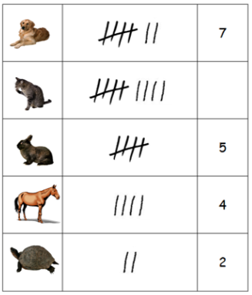
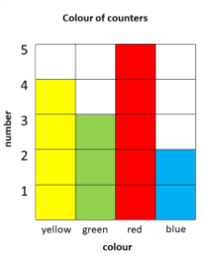
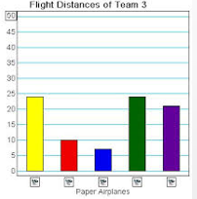
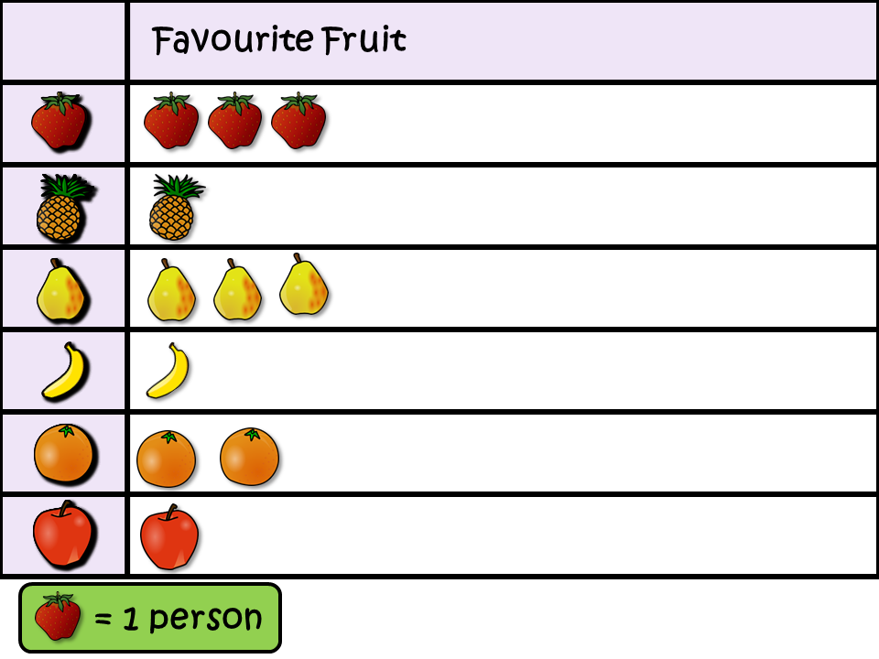
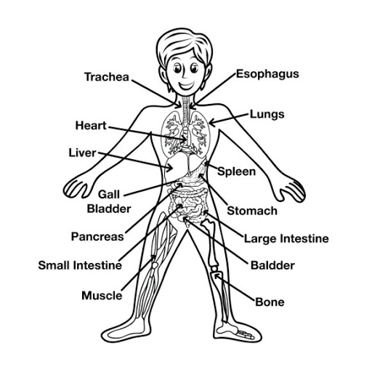
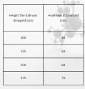
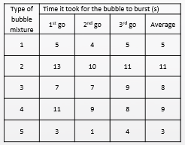

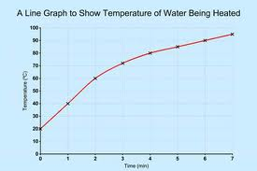
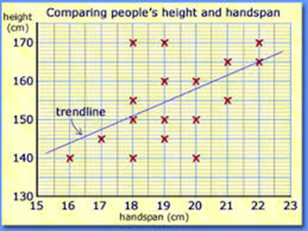
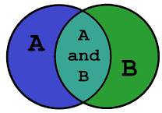











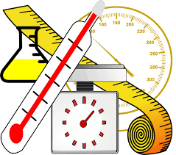
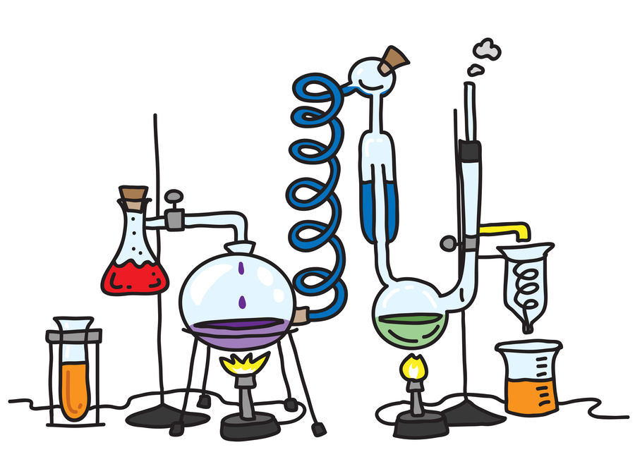







Science Knowledge Organiser
Working Scientifically
Year 5
Recording Data
Labelled diagram
Tables
Block graph
Bar chart
Pictogram
Planning and Communication and Sources
Enquiring and Testing and Obtaining and Presenting Evidence
Line
graph
Scatter
graph
Sorting diagram
Give scientific explanations by using:
Key Vocabulary | Definition
systematically | In a regular and ordered way.
quantitative data | Information that is counted or measured.
qualitative data | Information that is observed and not in numbers.
key factors | The most important parts of an experiment.
experimental evidence | Things found to be true from the result of an experiment.
experiment | A carefully planned test used to discover something unknown.
apparatus | A set of equipment used in an experiment.
method | The way the experiment is done.
conclusion | Things that can be worked out from the results of an experiment.
Previous knowledge
Record observations systematically.
Communicate quantitative and qualitative data in a scientific way.
Experimental evidence
Use a range of sources of information.
Recognise key factors when carrying out a fair test.
Observing and Recording
Considering Evidence and Evaluating
+
Make a series of accurate observations, comparisons and measurements.
Choose correct apparatus for different tasks.
Make predictions based on knowledge and understanding.
Relate evidence to scientific knowledge and understanding.
Explain differences in results.
Plan to use apparatus to get results.
Begin to make repeat observations and measurements systematically.
Draw conclusions from the evidence.
Suggest how methods could be improved.

