Slide 1
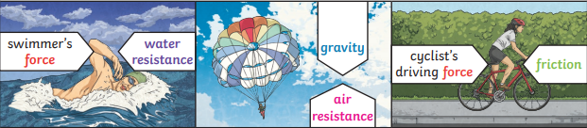
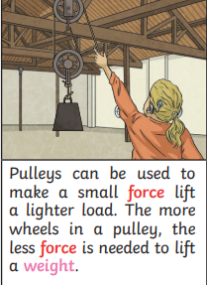
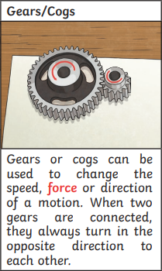
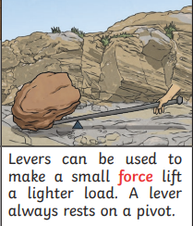
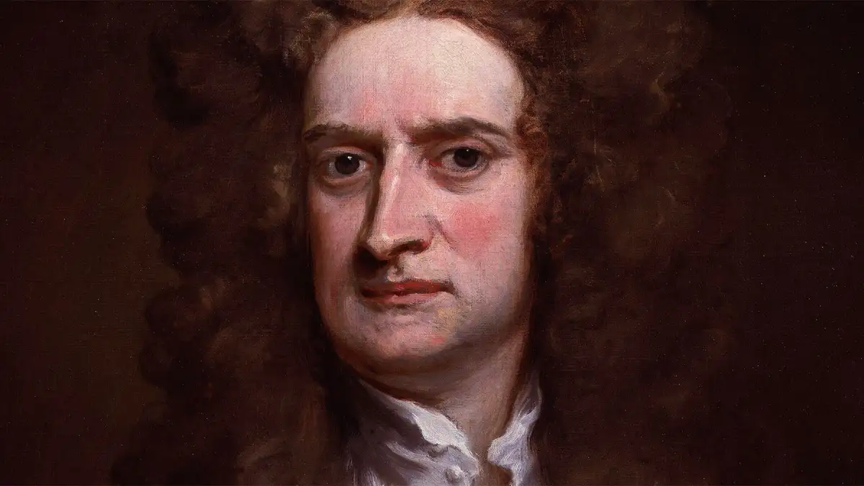
Science Knowledge Organiser
Forces
Year 5
Diagrams and Symbols
Key Vocabulary | Definition
forces | Pushes or pulls.
gravity | A pulling force exerted by the Earth (or anything else which has mass).
Earth’s gravitational pull | The pull that Earth exerts on an object, pulling it towards Earth’s centre.
weight | The measure of the force of gravity on an object.
mass | A measure of how much matter is inside an object.
friction | A force that acts between two surfaces or objects that are moving, or trying to move, across each other.
air resistance | A type of friction caused by air pushing against any moving object.
water resistance | A type of friction caused by water pushing against any moving object.
buoyancy | An upward force that a liquid applies to objects.
streamlined | When an object is shaped to minimise the effects of air or water resistance.
mechanism | Parts which work together in a machine. E.g. pulleys, gears and levers.
What? (Key Knowledge)
Forces can make an object: Start to move, stop moving, change direction, change its shape, move faster or move more slowly.
Mass is how much matter is inside an object. It is measured in kilograms (kg). |  | Weight is how strongly gravity is pulling an object down. It is measured in newtons (N).
The Moon has a smaller mass than Earth so the gravitational pull on the Moon is smaller than it is on Earth. Jupiter has a greater mass than Earth so the gravitational pull on Jupiter is stronger than on Earth.
Isaac Newton | Isaac Newton is famously thought to have developed his theory of gravity when he saw an apple fall to the ground from an apple tree.
Water resistance and air resistance are forms of friction.
Key Figures and Scientists
Isaac Newton

