Slide 1
Phonics Workshop
For Parents

Slide 2


Slide 3


Slide 4


Slide 5


Slide 6
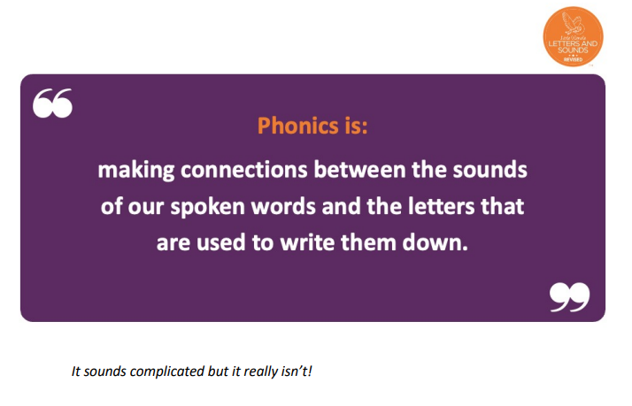

Slide 7
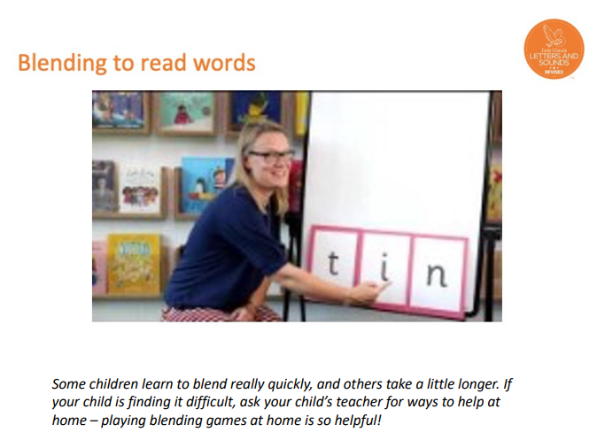

Slide 8
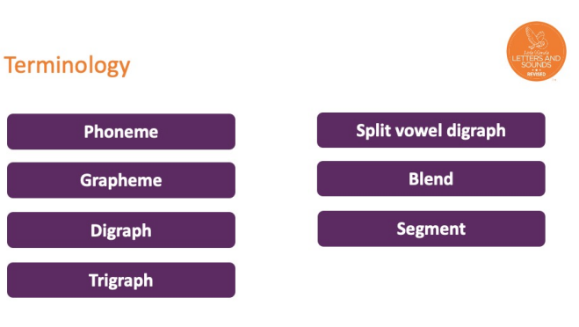

Slide 9
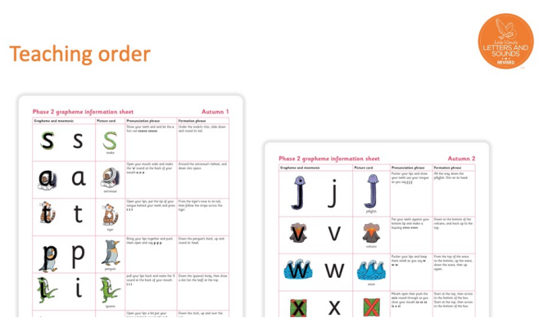
We teach four new sounds a week and have a review lesson on a Friday. You will get a list of the sounds that we are learning to have at home. This will help you with formation and pronunciation.

Slide 10
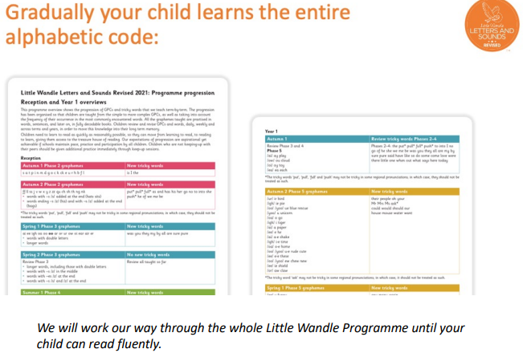

Slide 11
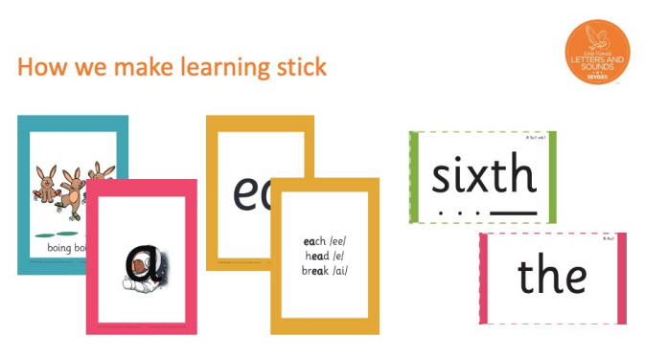

Slide 12
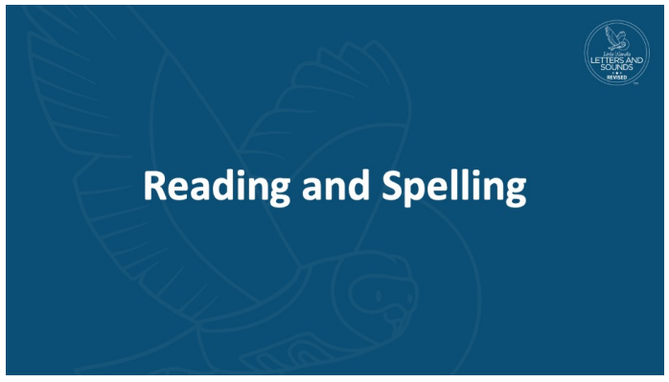

Slide 13
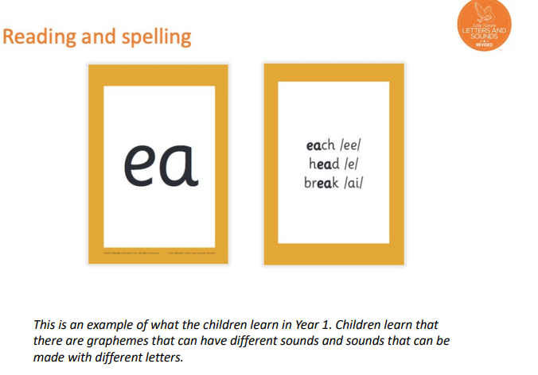
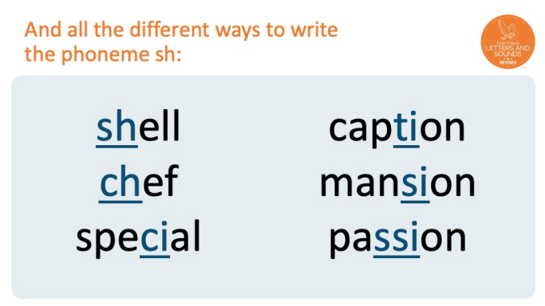

Slide 14


Slide 15
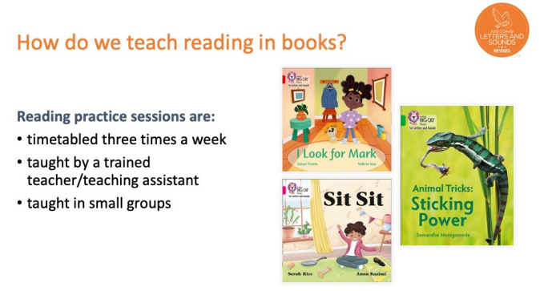
Decoding
Prosody
Comprehension
4th read a similar skill book at home for fluency

Slide 16
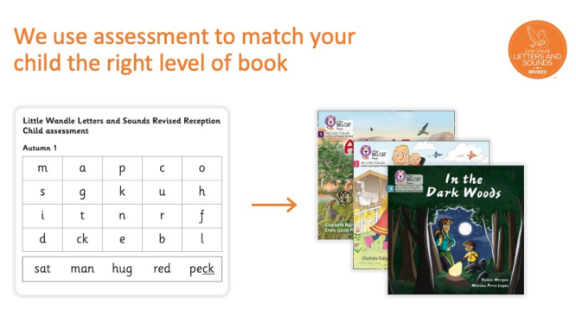

Slide 17
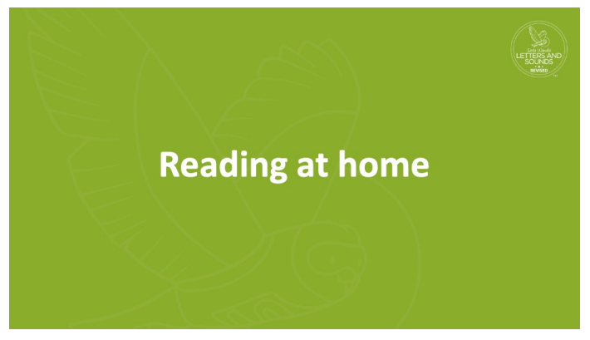

Slide 18
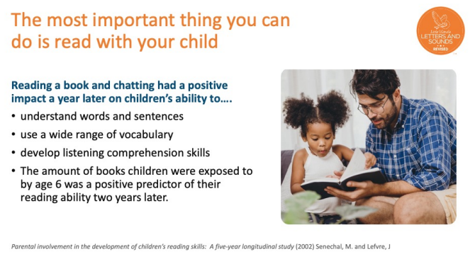

Slide 19
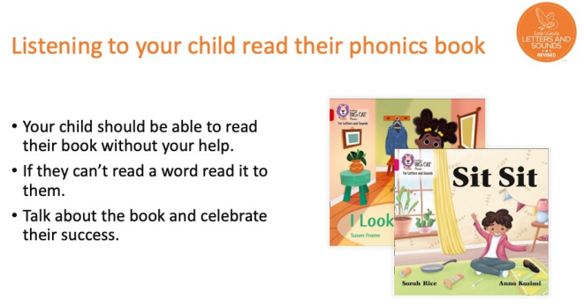

Slide 20
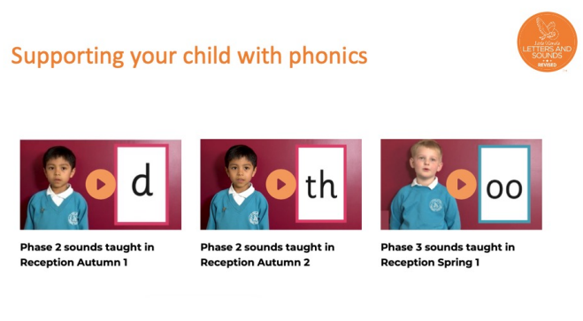
It is really important that you pronounce the sounds correctly at home if you are supporting your child. These videos are on the website for you to refer to and if you are unsure, please ask your child’s teacher.

Slide 21
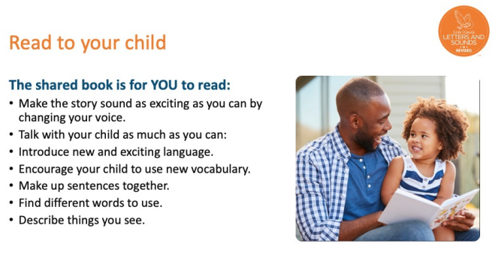

Slide 22


