Slide 1

Reading Inspire Workshop
Year 1

Slide 2
Did you know?
Reading for pleasure is linked to benefits such as academic progress.
Reading for pleasure is linked to improved vocabulary.
Reading for pleasure is linked to improved general knowledge.
Regularly reading outside of school is associated with higher scores in reading assessments.

Slide 3
HOW OFTEN SHOULD MY CHILD READ?
The children are expected to have evidence of reading at home in their Reading Records.
Children should read a small amount each day.
Ideally, the children should read their book 3 times to achieve fluency.

Slide 4
Reward systems in school
These certificates are awarded during Celebration Assemblies:
Emerald Award = 25 reads
Sapphire Award = 75 reads
Gold Award = 150 reads
Diamond Award = 300 reads!

Slide 5
How can I help my child at home?
Encourage them to read anything that they enjoy!
If they are stuck on a word, encourage them to say the sounds and blend them together.
Don’t worry about telling your child a word to keep up the flow of their reading.
Re reading their book will increase their confidence and fluency
Ask them questions about the books they are reading. Look for examples of questions in their reading records.

Slide 6
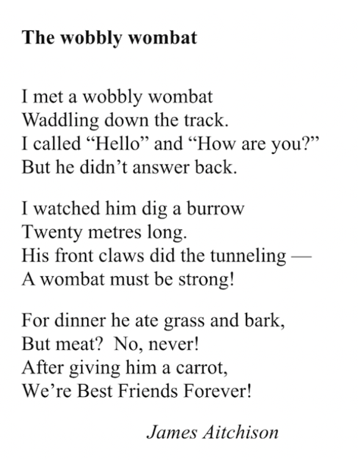
Our Reading Theatre text: ‘The Wobbly Wombat’ by James Aichison

Slide 7
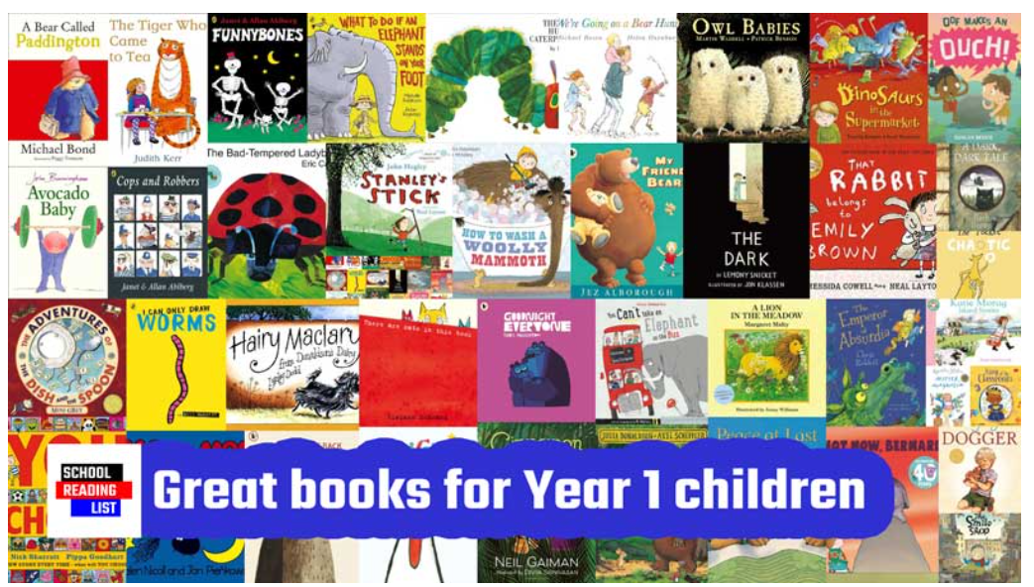
WHAT SORTS OF texts should my child read?
These websites provide recommendations of books appropriate for children in Year 1.
School Reading List:
Year 1 reading list for children aged 5-6 | School Reading List
Books for Topics:
Best Books for Year 1: Recommended Booklist for Ages 5-6

