Slide 1
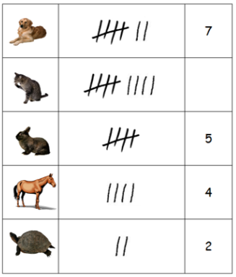
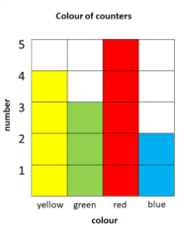
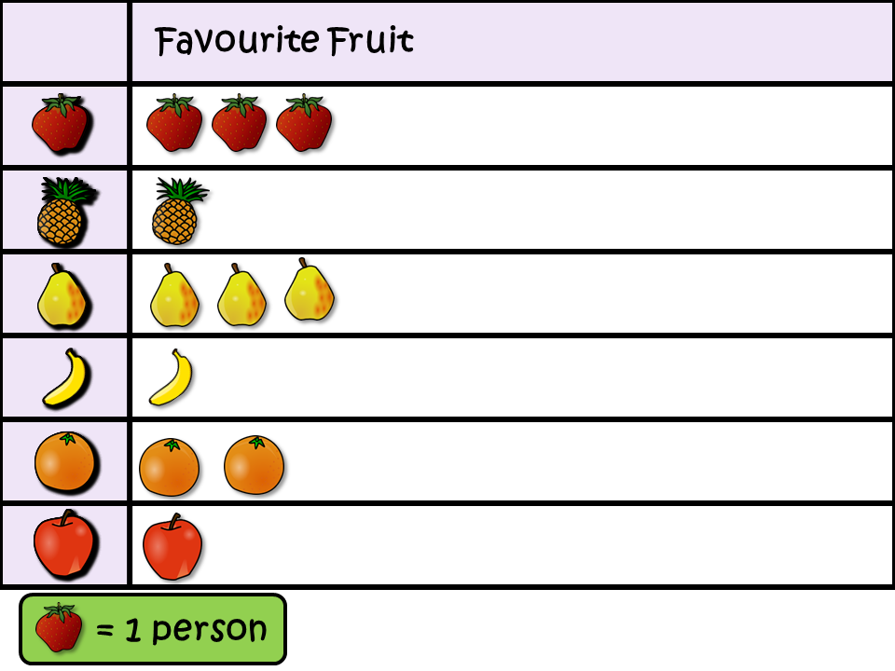
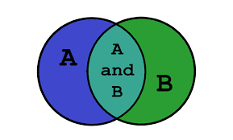
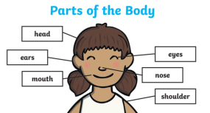
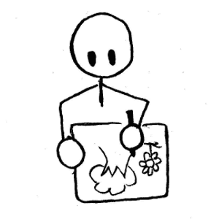


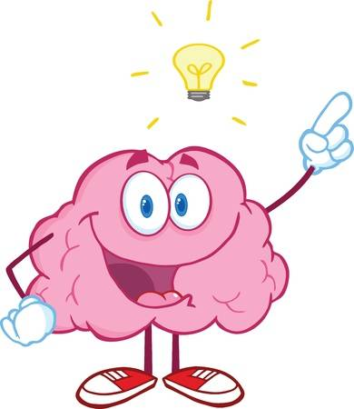

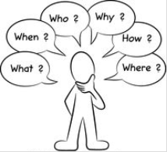
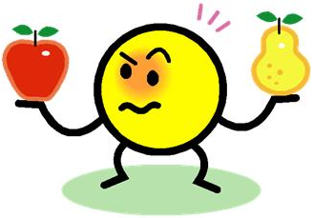
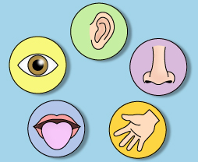
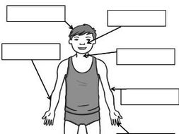



Science Knowledge Organiser
Working Scientifically
Year 1
Recording Data
Pictogram.
Table
Block graph
Sorting
diagram.
Labelled diagram
Planning and Communication and Sources
Enquiring and Testing and Obtaining and Presenting Evidence
Draw simple pictures.
Talk about what you see.
Predict what might happen.
Key Vocabulary | Definition
predict | When you say what you think will happen.
compare | Look at the similarities and differences between objects or groups.
key features | The most important parts.
chart | A way of showing information.
senses | Our five senses are sight, hearing, smell, taste and touch.
observe | When we look closely at something.
observation | What we have seen or found out.
labels | Labels show different parts of a diagram.
ICT | Technology such as computers, laptops and tablets.
diagram | A simple drawing to show what something looks like or how it works.
Use what you know to answer questions.
Find the key features.
Use simple charts.
Compare some living things.
Ask questions.
Observing and Recording
Considering Evidence and Evaluating
Use your senses to observe.
Compare and group.
Record observations by:
labelling
Say what has happened.
writing
talking
drawing
using
ICT
Say if what happened was what was expected.

