Slide 1
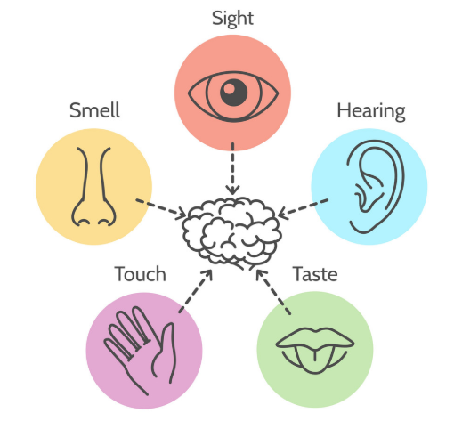
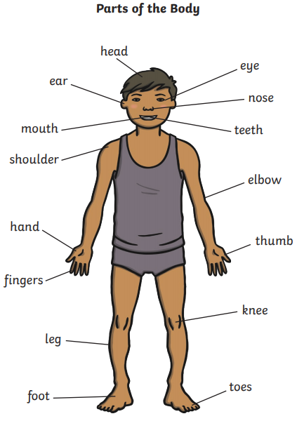
Science Knowledge Organiser
Animals, including humans
Year 1
Diagrams and Symbols
Our 5 Senses
What? (Key Knowledge)
Ourselves
Our senses | We have 5 senses: Sight Hearing Smell Taste Touch
Our senses | Different parts of our bodies are associated with each of our five senses: Sight- eyes Hearing- ears Smell- nose Taste- tongue Touch- skin
Our bodies | Our bodies are made up of different body parts- Head, neck, arms, elbows, legs, knees, face, ears, eyes, hair, mouth, teeth
Key Vocabulary | Definition
Sight | Your eyes let you see all the things around you.
Hearing | Your ears let you listen to all the things around you. Your brain is able to tell what different sounds are.
Touch | Your skin gives you the sense of touch. You can tell if something is warm, cold, smooth or rough without even looking at it!
Taste | Your sense of taste comes from your tongue. You can tell if something tastes bitter or sweet. You might have some tastes you like and some you don’t.
Smell | You smell using your nose. Your nose can tell if things smell nice or not nice.

