Slide 1
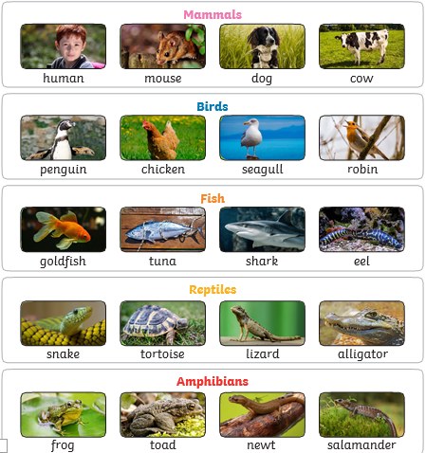
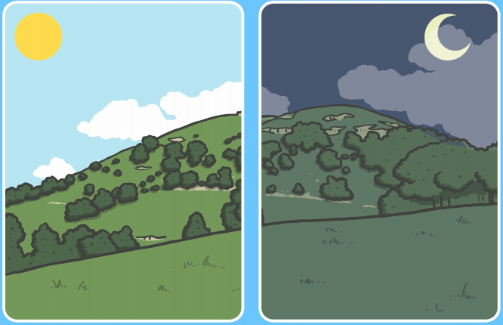
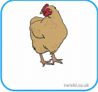
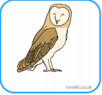
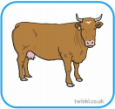
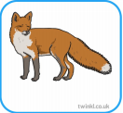

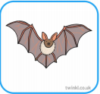

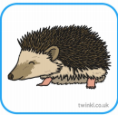
Science Knowledge Organiser
Animals, including humans
Year 1
Diagrams and Symbols
Key Vocabulary | Definition
amphibians | Amphibians live in the water as babies and on land as they grow older. They have smooth, slimy skin.
birds | All birds have a beak, two legs, feathers and wings.
fish | Fish live and breathe under water. They have scaly skin, fins to help them swim and they breathe through gills.
mammals | Mammals are animals that breathe air, grow hair or fur and feed on their mother’s milk as a baby.
reptiles | All reptiles breathe air. They have scales on their skin.
carnivore | An animal that only eats meat.
herbivore | An animal that only eats plants.
omnivore | An animal that eats meat and plants
nocturnal | An animal that is active at night.
diurnal | An animal that is active in the daytime.
What? (Key Knowledge)
Animals are living things.
Like plants, animals need food and water to live.
Unlike plants (which make their own food) animals feed themselves by eating plants or other animals.
Millions of animals live on Earth.
Humans are animals.
Animals who eat plants only are called herbivores, animals who eat other animals are called carnivores, animals who eat plants and animals are called omnivores.
Animals can be grouped into different types- mammals, reptiles, birds, fish and amphibians.
Some animals are active in the daytime (diurnal) and some animals are active at night (nocturnal).
diurnal
nocturnal

