Slide 1
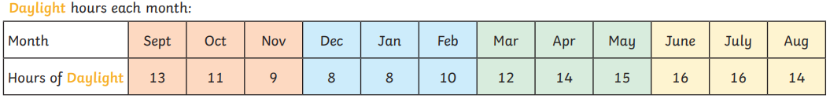
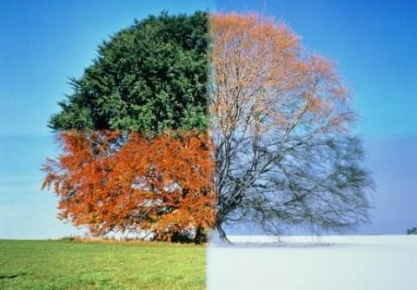
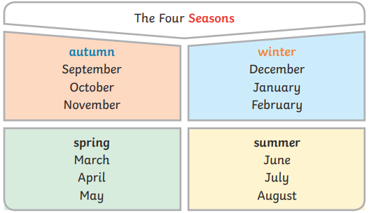
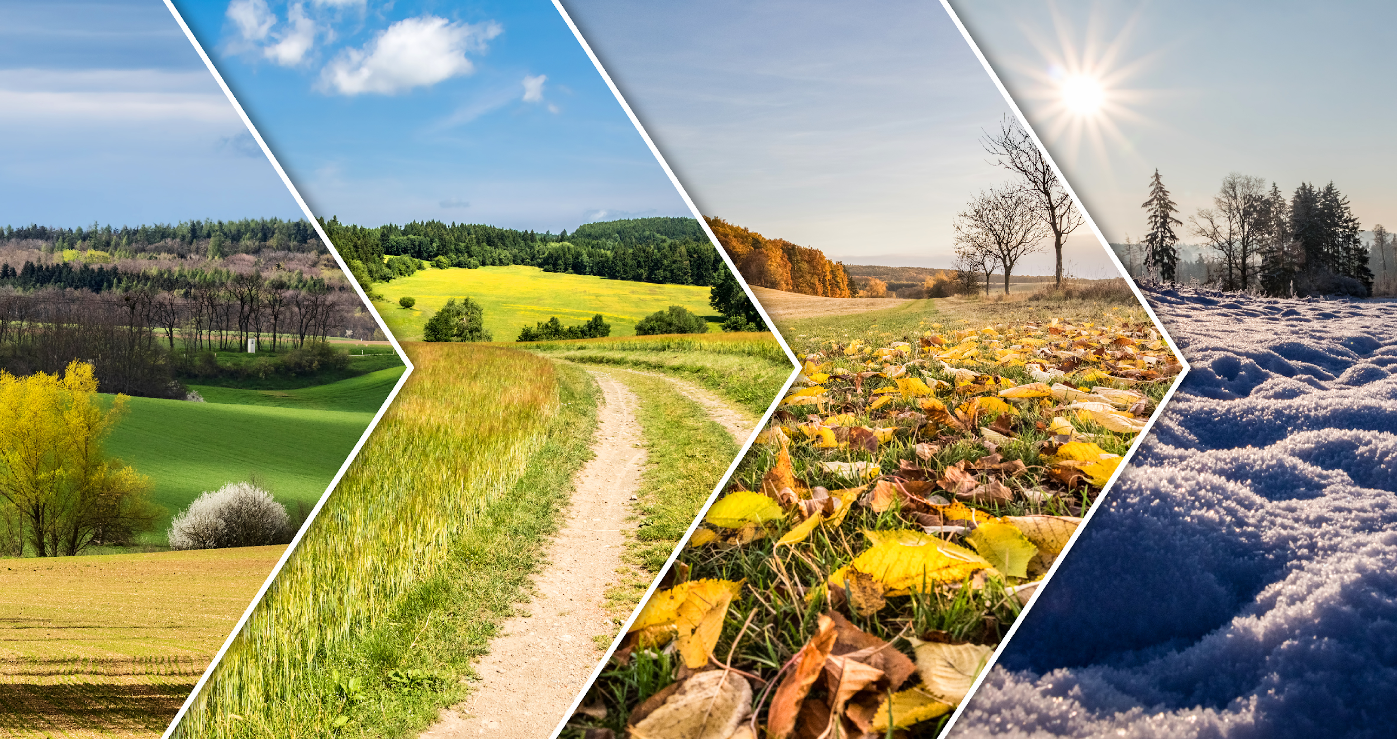
Science Knowledge Organiser
Seasonal changes
Year 1
Diagrams and Symbols
What? (Key Knowledge)
Seasons are different times in the year when there are weather changes.
Seasons have an effect on landscapes (eg fields, gardens, parks, forests) and plant and animal life.
The length of day changes as the seasons change.
There are four seasons- spring, summer, autumn and winter.
Spring | The weather gets warmer Baby animals are born and new flowers blossom
Summer | The warmest season Insects such as wasps and bees are around and plants have lots of leaves.
Autumn | The weather gets cooler Some leaves turn brown and fall from trees
Winter | The coldest season Many trees have no leaves and animals are hibernating
Key Vocabulary | Definition
seasons | There are four seasons each year, autumn, winter, spring and summer.
weather | The weather includes the temperature outside, the wind direction and strength, as well as rain, cloud, snow and sun.
daylight | When it is light outside.
hibernate | When an animal or plant spends the winter sleeping.
deciduous | A tree or plant that loses its leaves in autumn.
evergreen | A tree or plant that keeps its green leaves all year.

