Slide 1
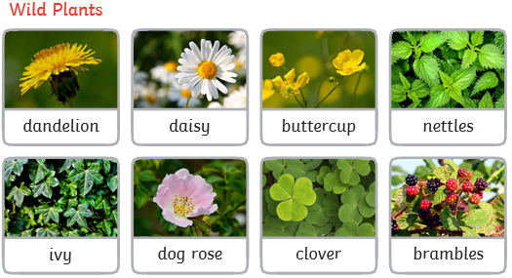
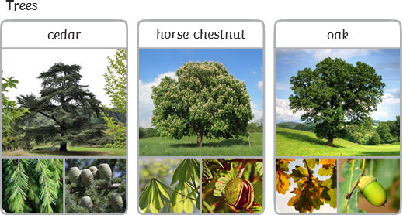
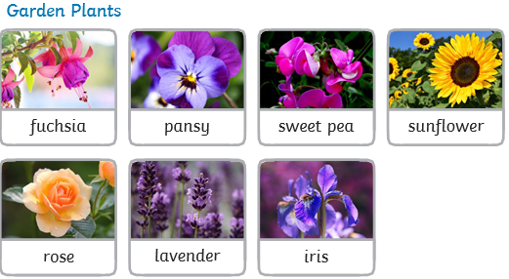
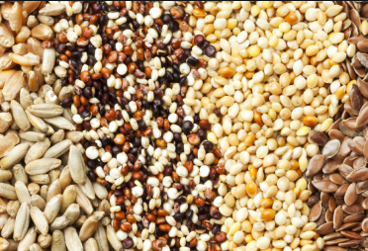
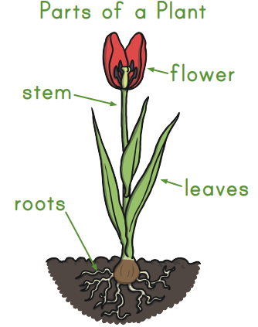
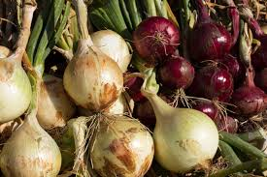
Science Knowledge Organiser
Plants
Year 1
Diagrams and Symbols
Key Vocabulary | Definition
roots | Roots take in water and nutrients from the soil.
stem | The stem holds the plant up and carries the water and nutrients from the roots to the leaves and flowers.
leaves | Leaves catch sunlight to make energy.
flowers | Flowers attract insects and birds.
petals | Petals are the colourful part of the flower.
fruit | Fruit contains the plant’s seeds.
seed | Seeds grow into new plants.
bulb | Bulbs grow into new plants.
tuber | A thick part of an underground stem. Eg a potato
germinate | When a seed begins to grow.
What? (Key Knowledge)
Plants have different parts that each have a job to do. The main parts of a flowering plant are the flower, the leaves, the stem and the roots.
Plants can grow from seeds (eg sunflower, apple tree) or bulbs (eg daffodils, onions). Roots (eg carrots, parsnips) and tubers (eg potato) can also be planted and will grow.
Wild plants | A wild plant seed grows where it falls. It doesn’t need to be planted or cared for as it grows.
Garden plants | Garden plants are plants that people choose to grow in their gardens.
Weeds | Weeds are wild plants that grow in places where people don’t want them.
Trees | Not all trees lose their leaves in the winter. A deciduous tree loses its leaves each year. An evergreen tree keeps its green leaves all year round, even in the winter.
seeds
bulbs

