Slide 1

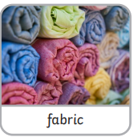
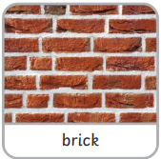
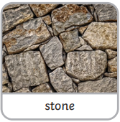
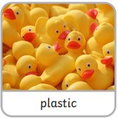
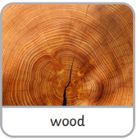
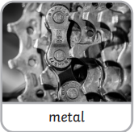
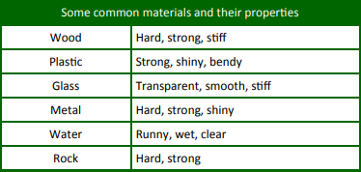
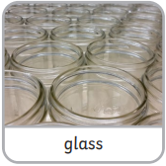
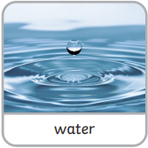
Science Knowledge Organiser
Everyday Materials
Year 1
Diagrams and Symbols
Key Vocabulary | Definition
material | Materials are what an object is made from.
hard | Not easily broken or bent.
soft | If something is soft, it is easy to cut, fold or change the shape of.
stretchy | Can be pulled to make it longer or wider without breaking.
shiny | Reflects light easily.
dull | Doesn’t reflect light. Doesn’t look bright or shiny.
rough | If something is rough, it feels and looks uneven or bumpy.
smooth | Smooth objects have no lumps or bumps.
waterproof | If something is waterproof, it keeps water out. It keeps things dry.
absorbent | If something is absorbent, it soaks water up.
transparent | Transparent objects can be seen through.
opaque | Opaque objects can’t be seen through.
bendy | Bendy things can be folded easily.
Materials
What? (Key Knowledge)
All objects have a name. Material is the stuff an object is made from.
There are lots of different types of materials.
Everyday materials include wood, fabric, plastic, metal, water and rock.
You can put materials into different groups by asking questions about them eg hard or soft? Not bendy or bendy? Waterproof or not waterproof?

