Slide 1


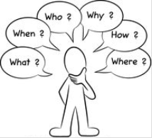

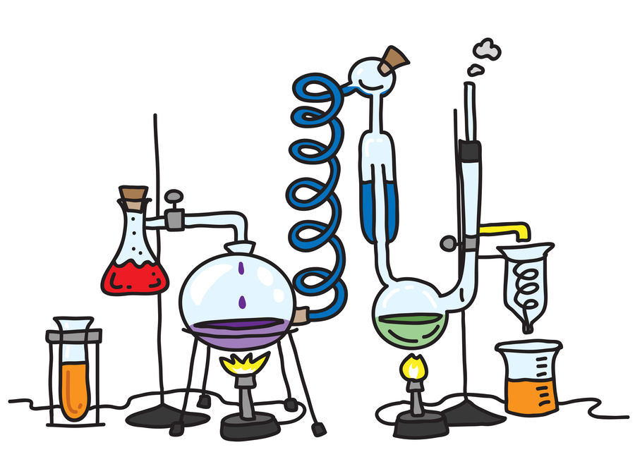
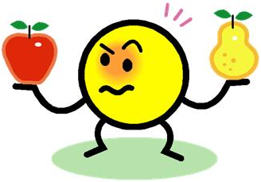










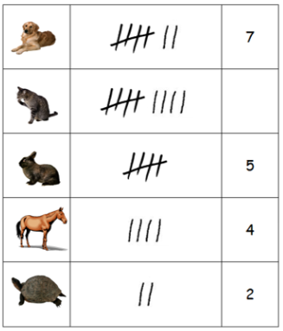
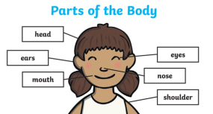
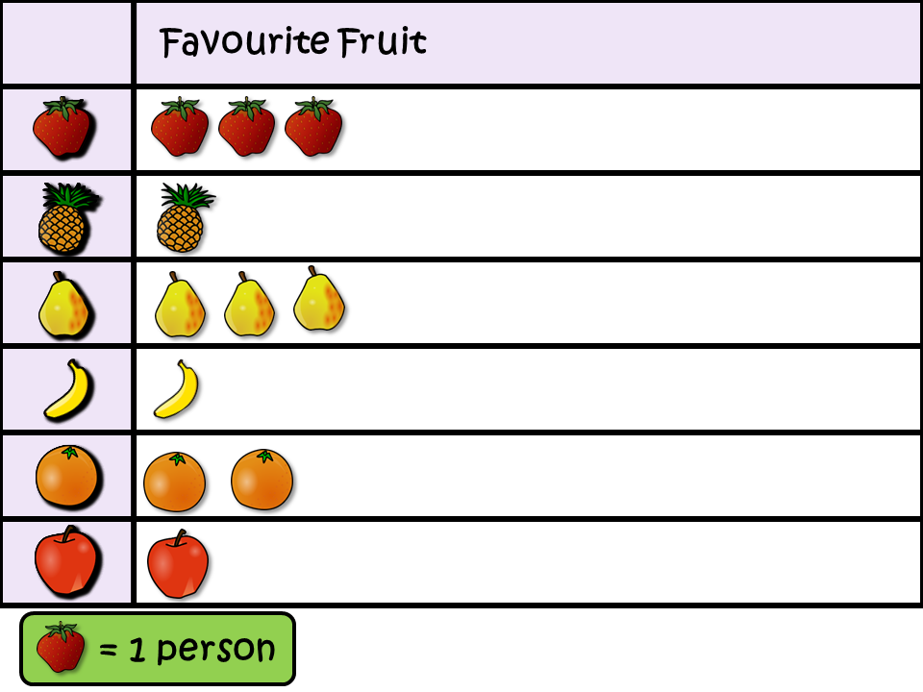
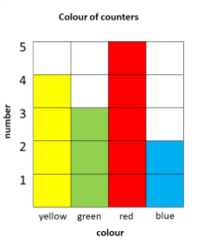
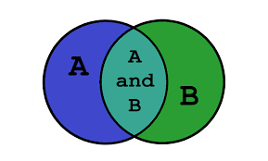
Science Knowledge Organiser
Working Scientifically
Year 2
Planning and Communication and Sources
Enquiring and Testing and Obtaining and Presenting Evidence
Key Vocabulary | Definition
key features | The most important parts.
Chart | A way of showing data.
data | Information that has been collected.
equipment | Things needed to test something.
test | A way of finding something out.
fair | It is equal or the same.
comparison | Looking at the similarities and differences.
conclusion | The answer from the data collected.
improvement | Making something better.
observation | What we have seen or found out.
Describe observations.
Suggest how to find things out.
Use simple equipment.
Compare objects, living things and events.
Begin to know if a test or comparison is fair.
Ask questions.
Use texts to find information.
Find the key features.
Make observations about the task.
Use what you know to answer questions.
Observing and Recording
Considering Evidence and Evaluating
Answer questions asked by the teacher.
Say what has happened.
Ask questions.
Say what observations show and if it was expected.
Collect and record data with help.
Recording Data
Begin to select the right equipment.
Suggest improvements.
Suggest how to collect data.
Draw conclusions and explain.
Table.
Labelled diagram.
Sorting
diagram.
Pictogram.
Block
graph.

