Slide 1
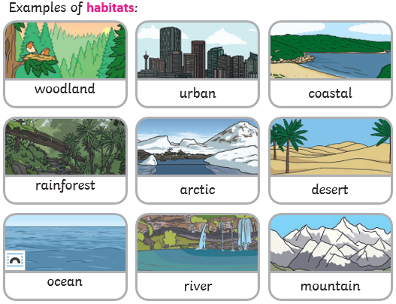
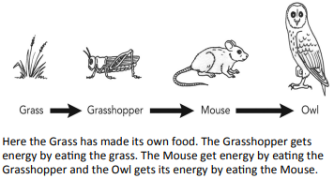
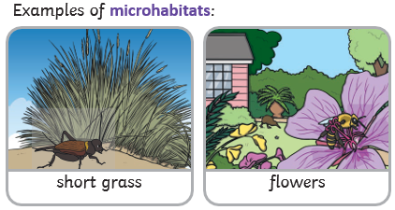
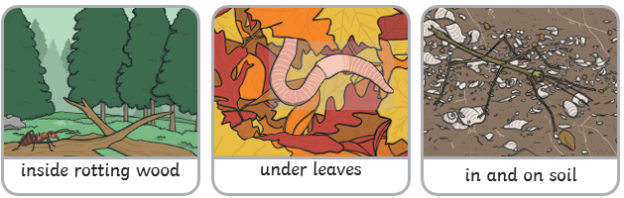
Science Knowledge Organiser
Living things and their habitats
Year 2
Diagrams and Symbols
Key Vocabulary | Definition
life processes | These are the things that all living things do e.g move, get energy from food, grow and reproduce.
living | Things that are living have all the life processes.
dead | Things that are dead were once living. They did have all the life processes but don’t now.
never living | Things made out of metal, plastic or rock were never living. They never had the life processes.
food chain | A food chain shows how each animal gets its food. Food chains are one of the ways that living things depend on each other to stay alive.
food sources | The place a living thing’s food comes from.
habitat | A habitat is the natural place something lives.
microhabitat | A microhabitat is a very small habitat in places like under a rock, under leaves or on a branch.
depend | Many living things in a habitat depend on each other. This means they need each other for different things.
survive | To stay alive.
What? (Key Knowledge)
Things can be split into three groups- things that are living, things that were living but are now dead and things that were never living.
Four life processes to show that something is alive: movement, reproduction (having offspring such as babies or seeds), nutrition (eating or making food for energy), growth
Most living things live in an environment they are suited to. This is their habitat.
A habitat provides living things with everything they need to survive such as food, shelter and water.
Habitats can be very different. For example they could be hot or cold, wet or dry, on the ground or up high.
Animals get their food from plants and other animals. A food chain shows how energy from food is passed along. Only green plants make their own food, so every food chain starts with a green plant.
A food chain

