Slide 1
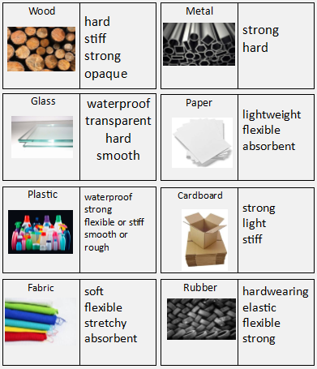
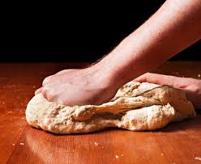
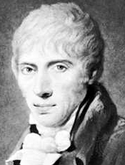

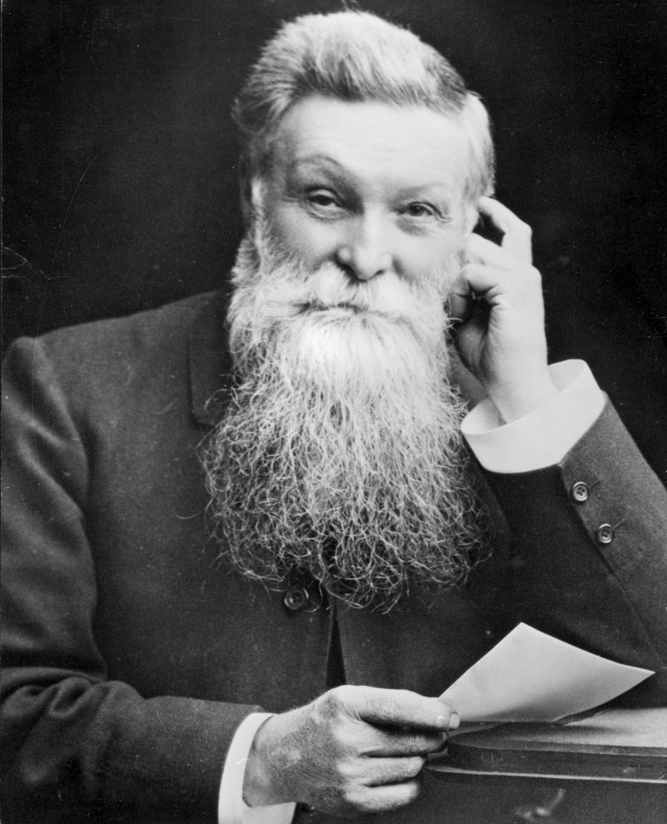
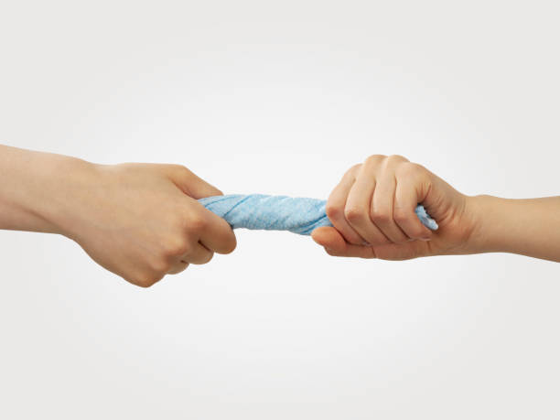
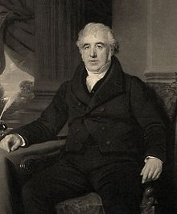
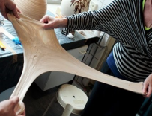
Science Knowledge Organiser
Use of everyday materials
Year 2
Diagrams and Symbols
Key Vocabulary | Definition
materials | Materials are what objects are made from.
suitability | Having properties that are right for a particular purpose.
properties | What a material is like and how it behaves.
rigid | A material that is fixed in its shape.
flexible | A material that can have its shape changed.
squash |  | Crush something so that it becomes flat, soft, or out of shape
bend |  | Changing a straight object so that it is curved.
twist |  | Change the shape of an object by turning it.
stretch |  | Made longer or wider without tearing or breaking
Properties of Everyday Materials
What? (Key Knowledge)
Materials are the substances that things are made from.
We use lots of materials every day eg metal, plastic, wood, glass.
Different materials have different properties.
Some materials are used to make many things because of their properties.
John McAdam |  | A Scottish engineer who created a new way of building roads called “macadamisation”.
John Dunlop |  | A Scottish inventor who invented the air filled rubber tyre in 1887.
Charles Macintosh |  | A Scottish inventor who invented waterproof fabrics in 1818.

