Slide 1
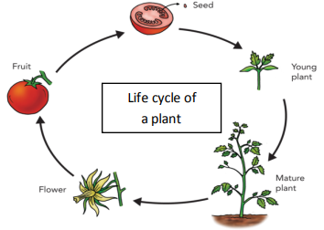
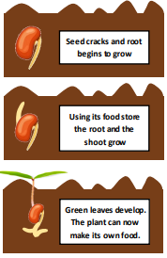
Science Knowledge Organiser
Plants
Year 2
Diagrams and Symbols
Key Vocabulary | Definition
germination | When the conditions are right, the seed soaks up water and swells, and the tiny new plant bursts out of its shell. This is called germination.
sprout | When a plant sprouts, it grows new shoots.
shoot | A shoot grows upwards from the seed or plant to find sunlight.
sunlight | Light from the sun.
water | All plants need water to grow. Without water, seeds and bulbs will not germinate.
temperature | Temperature is how warm or cold something or somewhere is.
nutrition | Food or nourishment. Plants make their own food in their leaves using sunlight.
survive | Continue to live or exist.
life cycle | A continuous series of changes showing the life of something.
What? (Key Knowledge)
When seeds start to grow this is called germination. Germination starts with the roots.
Seeds need warmth, air (oxygen) and water to germinate.
The main parts of a plant are the flower, the stem, the leaves and the roots.
To grow and survive plants need light, water and carbon dioxide to make their own food.
Seeds do not need light as they have a store of food.
Some plants like cooler temperatures and some like warmer temperatures.
All plants need sunlight to grow well. Some plants need a lot of sunlight to survive. Some plants need little sunlight to survive.
Germination

