Slide 1
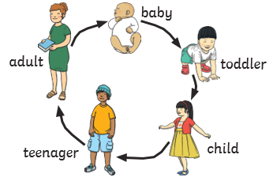
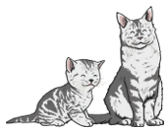
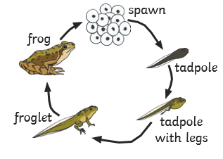
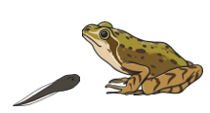
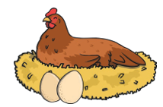
Science Knowledge Organiser
Animals, including humans
Year 2
Diagrams and Symbols
Key Vocabulary | Definition
adult | A fully grown up animal or plant.
develop | To grow and become stronger.
life cycle | The changes living things go through to become an adult.
offspring | The child of an animal.
reproduce | When living things make a new living thing of the same kind.
young | Offspring that has not reached adulthood.
live young | Offspring that has not hatched from an egg.
All young animals change at different stages as they grow into adults.
What? (Key Knowledge)
Growth and change
All living things reproduce and have offspring
Some animals give birth to live young. Their offspring normally look like them when they are born.
Some animals have offspring which do not look like them, e.g. fish and amphibians.
Some animals lay eggs which hatch into live young. This young then develops into an adult. When these eggs hatch, some animals look like their adult, e.g. birds and reptiles.

