Slide 1
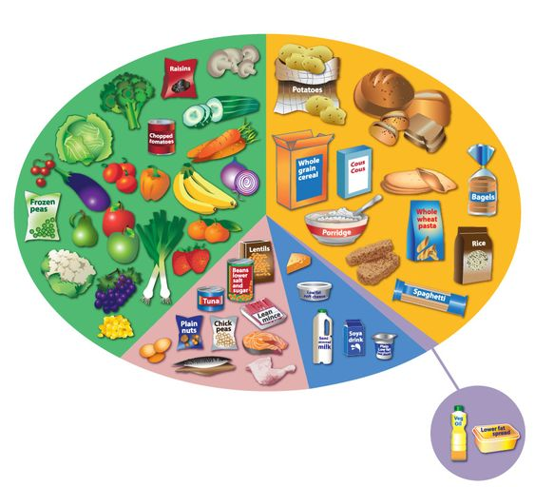
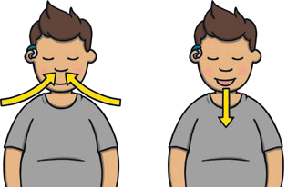
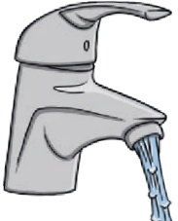
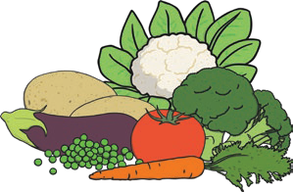
Science Knowledge Organiser
Animals including Humans
Year 2
Diagrams and Symbols
Key Vocabulary | Definition
dehydrate | To lose water (dry out).
diet | The food and water that an animal needs.
disease | Illness or sickness.
energy | The power needed to carry out a task.
exercise | A physical activity to keep your body fit.
germs | Bugs that cause disease and illness.
heart rate | The number of times a heart beats in one minute.
hygiene | How clean something is (to stay healthy and stop disease and illness spreading).
nutrition | Food needed to live.
pulse | The beating of the heart that can be felt in your neck and wrist.
fruit and vegetables
Eatwell Guide
carbohydrates
What? (Key Knowledge)
Exercise, diet and hygiene
To stay alive, all animals have 3 basic needs: air, water and food.
To grow into a healthy adult, we must eat the right types of food in the right amount and exercise.
We should drink 6-8 glasses of water a day. Water, lower fat milk, sugar-free drinks including tea and coffee all count.
To stop illness and infections spreading, we must be hygienic and keep ourselves clean.
proteins
dairy and alternatives
oils and spreads
Three basic needs:
air
water
food

