Slide 1
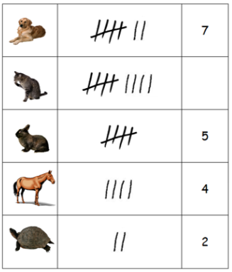
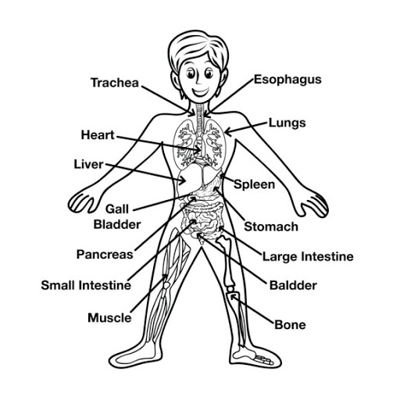
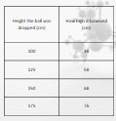

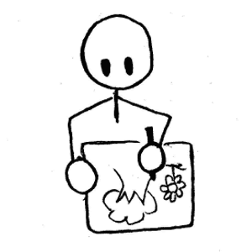




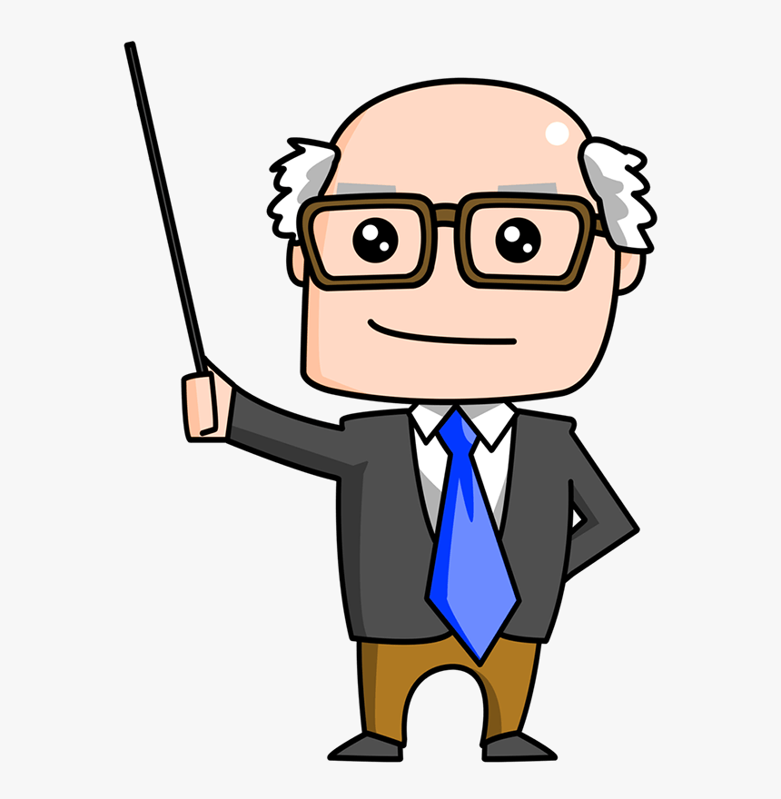





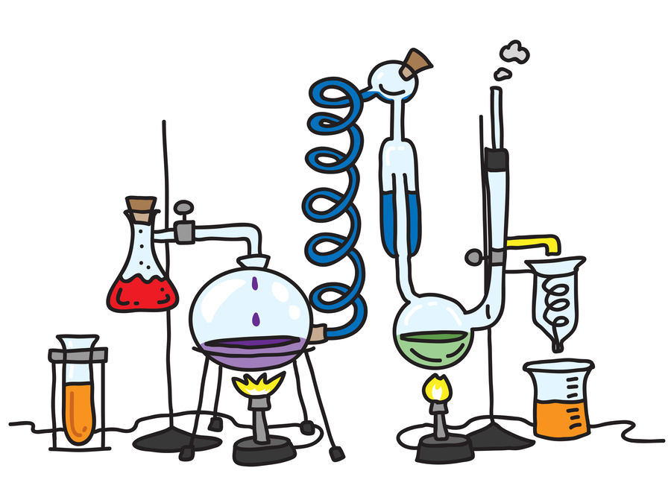


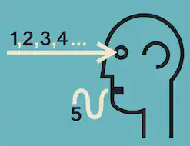
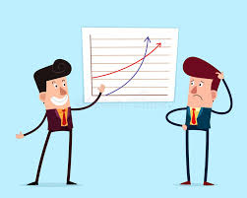
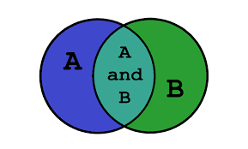
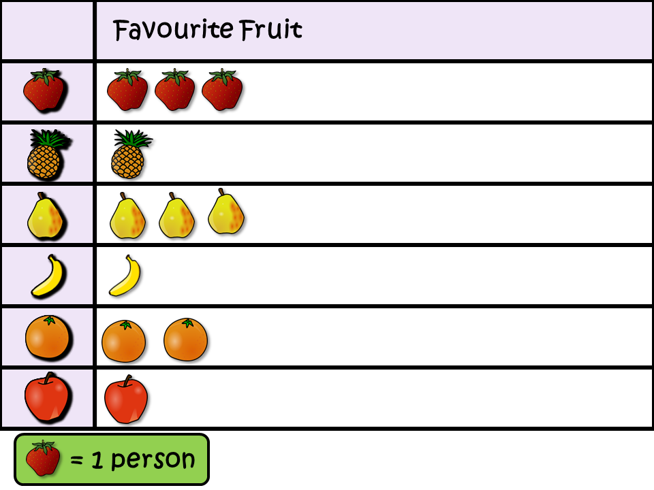
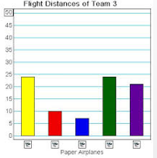

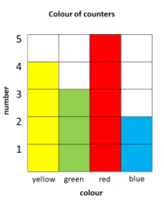
Science Knowledge Organiser
Working Scientifically
Year 3
Planning and Communication and Sources
Enquiring and Testing and Obtaining and Presenting Evidence
Be able to use:
Suggest ideas to answer questions.
Know that data is needed to answer questions.
tables
Key Vocabulary | Definition
scientific | Everything to do with science. This could be words or the way things are done.
data | Information that has been collected.
fair test | When you change one thing but keep everything else the same.
equipment | Things needed to test something.
research | Investigating to find new facts and answer questions.
evaluate | Form an idea from the data collected.
pattern | Something that repeats and can be predicted.
observation | What we have seen or found out.
improvement | Making something better.
Recording Data
diagrams
Carry out a fair test with support.
pictures
writing
Use texts to find information.
Choose how to record observations:
Begin to know that scientific ideas come from research.
in a table
Recognise and explain a fair test.
in writing
pictorially
in diagram form
Observing and Recording
Considering Evidence and Evaluating
Make observations.
Explain and communicate in a scientific way.
Choose the right equipment.
Identify patterns.
Evaluate findings.
Suggest improvements.
Measure using equipment.
Labelled diagram
Sorting
diagram.
Pictogram
Bar
chart
Table
Block
graph

