Slide 1
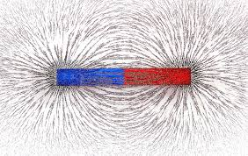
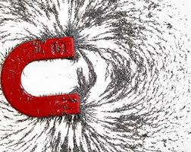
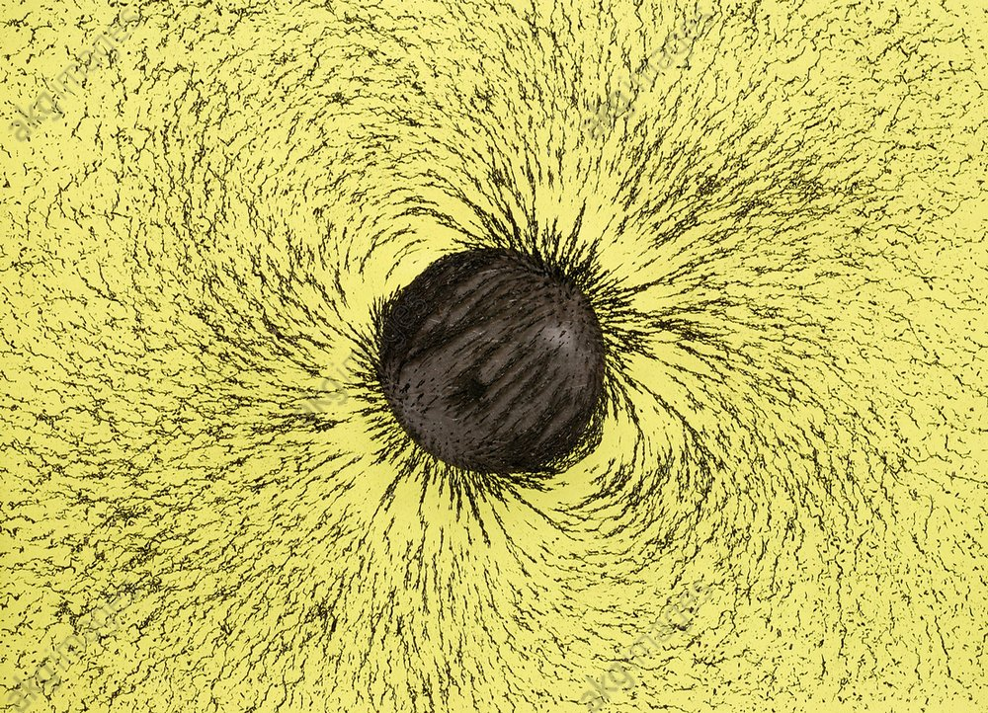
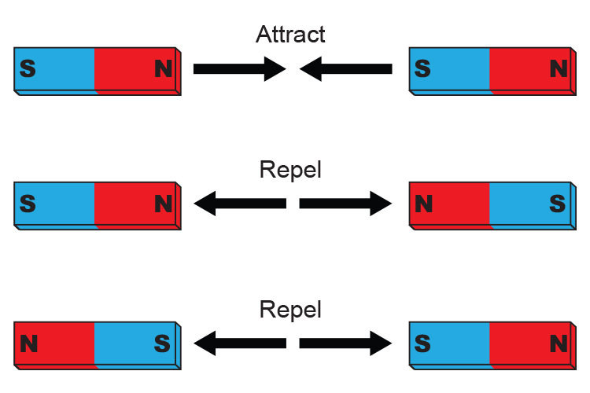
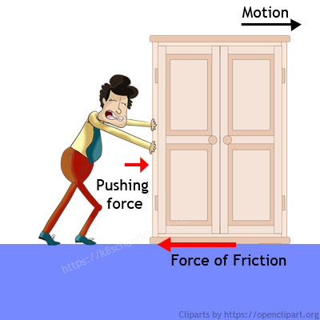
Science Knowledge Organiser
Forces and magnets
Year 3
Diagrams and Symbols
Key Vocabulary | Definition
forces | Pushes or pulls.
friction | A force that acts between two surfaces or objects that are moving, or trying to move, across each other.
surface | The top layer of something.
magnet | An object which produces a magnetic force that pulls certain objects towards it.
magnetic | Objects which are attracted to a magnet are magnetic. Objects containing iron, nickel or cobalt metals are magnetic.
magnetic field | The area around a magnet where there is a magnetic force which will pull magnetic objects towards the magnet.
poles | North and south poles are found at different ends of a magnet.
repel | Repulsion is a force that pushes objects away. For example, when a north pole is placed near the north pole of another magnet, the two poles repel (push away from each other).
attract | Attraction is a force that pulls objects together. For example, when a north pole is placed near the south pole of another magnet, the two poles attract (pull together).
Magnetic Fields
What? (Key Knowledge)
Different surfaces create different amounts of friction. The amount of friction created by an object moving over a surface depends on the roughness of the surface and the object, and the force between them
Forces will change the motion of an object. They will either make it start to move, speed up, slow it down or even make it stop.
A magnetic field is invisible. There is an invisible magnetic field, surrounding the Earth.
Magnets have a north pole and a south pole. Like poles repel. Opposite poles attract.
Not all metals are magnetic. The only magnetic metals are: Iron, Cobalt, Nikel and rare metal alloys (mixtures),
bar magnet
horseshoe magnet
disc magnet
Friction

