Slide 1
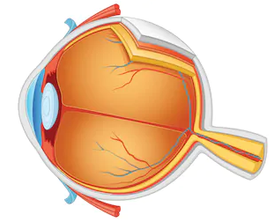
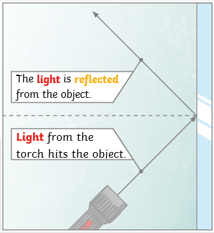
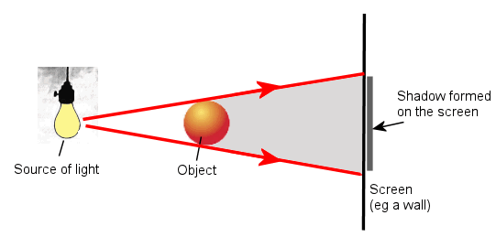
Science Knowledge Organiser
Light
Year 3
Diagrams and Symbols
Key Vocabulary | Definition
light | A form of energy that travels in a wave from a source.
light source | An object that makes its own light.
dark | Dark is the absence of light.
reflection | The process where light hits the surface of an object and bounces back into our eyes.
reflect | To bounce off.
reflective | A word to describe something which reflects light well.
ray | Waves of light are called light rays.
pupil | The black part of the eye which lets light in.
retina | A layer at the very back of the eye. The retina takes the light the eye receives. It then changes it into nerve signals to send to the brain.
shadow | An area of darkness where light has been blocked.
opaque | Describes objects that do not let any light pass through them.
translucent | Describes objects that let some light through, but scatter the light so we can't see through them properly.
transparent | Describes objects that let light travel through them easily, meaning that you can see through the object.
The Human Eye
retina
What? (Key Knowledge)
We need light to be able to see things. Light travels in a straight line. When light hits an object, it is reflected (bounces off). If the reflected light hits our eyes, we can see the object. Some surfaces and materials reflect light well. Other materials do not reflect light well. Reflective surfaces and materials can be very useful.
The surfaces that reflect light best are smooth, shiny and flat.
Mirrors reflect light very well, so they create a clear image. An image in a mirror appears to be reversed. For example, if you look in a mirror and raise your right hand, the mirror image appears to raise its left hand.
The pupils control the amount of light entering the eyes. If too much light enters, then it can damage the retina.
A shadow is caused when light is blocked by an opaque object. A shadow is larger when an object is closer to the light source. This is because it blocks more of the light.
pupil
Reflection
Show formation

