Slide 1
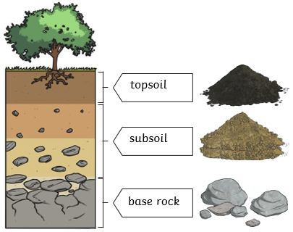
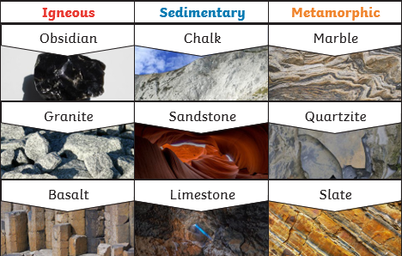
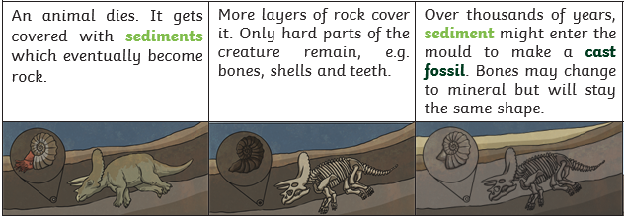
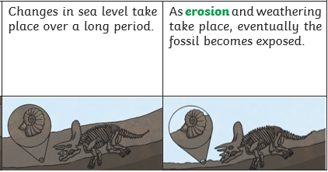
Science Knowledge Organiser
Rocks
Year 3
Diagrams and Symbols
Key Vocabulary | Definition
igneous rock | Rock that has been formed from magma or lava.
Sedimentary rock | Rock that has been formed by layers of sediment being pressed down hard and sticking together.
Metamorphic rock | Rock that started out as igneous or sedimentary rock but changed due to being exposed to extreme heat or pressure.
Magma | Molten rock that remains underground.
Lava | Molten rock that comes out of the ground.
Sediment | Natural solid material that is moved and dropped off in a new place by water or wind, e.g. sand.
permeable | Allows liquids to pass through it.
impermeable | Does not allow liquids to pass through it.
fossilisation | The process by which fossils are made.
paleontology | The study of fossils.
erosion | When water, wind or ice wears away land.
Soil
What? (Key Knowledge)
There are three types of naturally occurring rock. These are igneous, sedimentary and metamorphic rock.
Natural Rock
Soil | Soil is the uppermost layer of the Earth. It is a mixture of different things, minerals, air and water. It also contains organic matter (including living and dead plants and animals).
Caves are formed when water permeates through the base rock and erodes some of the rock away. Over thousands of years these caves can become very large.
Fossilisation

