Slide 1
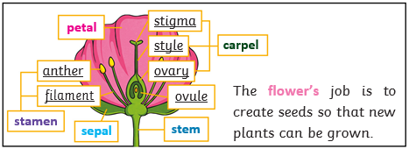
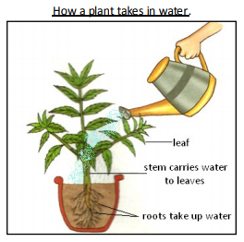
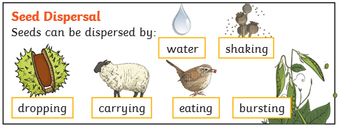
Science Knowledge Organiser
Plants
Year 3
Diagrams and Symbols
Key Vocabulary | Definition
fertilisation | When the male and female parts of the flower have mixed in order to make seeds for new plants.
petal | The brightly coloured part of the flower that attracts insects to pollinate the plant.
stamen | The male parts of the flower. The stamen is made up of the anther and the filament.
carpel | The female parts of the flower. Made up of the stigma, style and ovary.
sepal | Leaf-like structures that protect the flower and petals before they open out.
pollination | When pollen is moved from the male anther of a flower to the female stigma.
pollinator | Animals or insects which carry pollen between plants.
seed dispersal | A method of moving the seeds away from the parent plant so that the seeds have the best chance of survival.
pollen | A fine powdery substance made in the anther.
nutrients | These substances are needed by a living things to grow and survive. Plants get nutrients from the soil and also make their own food in their leaves.
What? (Key Knowledge)
flowers | Have colour and smell to attract insects.
leaves | Change carbon dioxide and water into food for plants. Oxygen is also created.
stem | Holds the plant up and carries water from the roots to the rest of the plant.
roots | Holds the plant up and soaks up water and minerals from the soil.
fruit | Keeps the seeds safe and aids seed dispersal.
The flower exists to make new plants. It has male and female parts.
The male part of the flower is called the stamen. The female part of the flower is called the carpel.
Pollen from the anther is taken to the flower’s carpel to create new seeds. The carpel is made up of the stigma, style and ovary.

