Slide 1
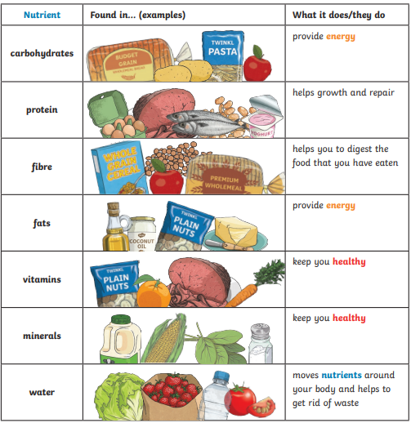
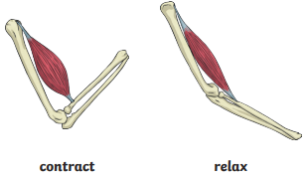
Science Knowledge Organiser
Animals, including humans
Year 3
Diagrams and Symbols
Key Vocabulary | Definition
healthy | In a good physical and mental condition
nutrients | Substances that animals need to stay alive and healthy.
energy | Strength to be able to move and grow.
vertebrate | Animals with backbones.
invertebrate | Animals without backbones.
muscles | Soft tissues in the body that contract and relax to cause movement.
tendons | Cords that join muscles to bones.
joints | Areas where two or more bones are fitted together.
What? (Key Knowledge)
Living things need food to grow and to be strong and healthy.
Plants can make their own food, but animals cannot.
To stay healthy, humans need to exercise, eat a healthy diet and be hygienic.
Animals, including humans, need food, water and air to stay alive.
Skeletons do three important jobs: protect organs inside the body; allow movement; support the body and stop it from falling on the floor.
Skeletal muscles work in pairs to move the bones they are attached to by taking turns to contract (get shorter) and relax (get longer).

Slide 2



