Slide 1
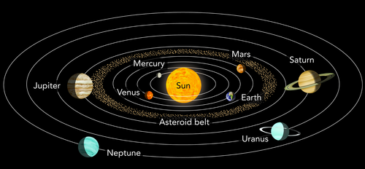
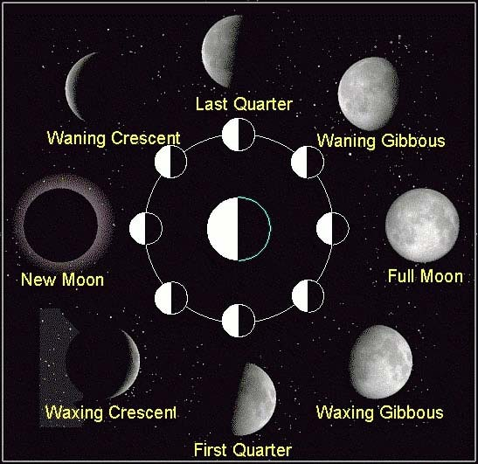
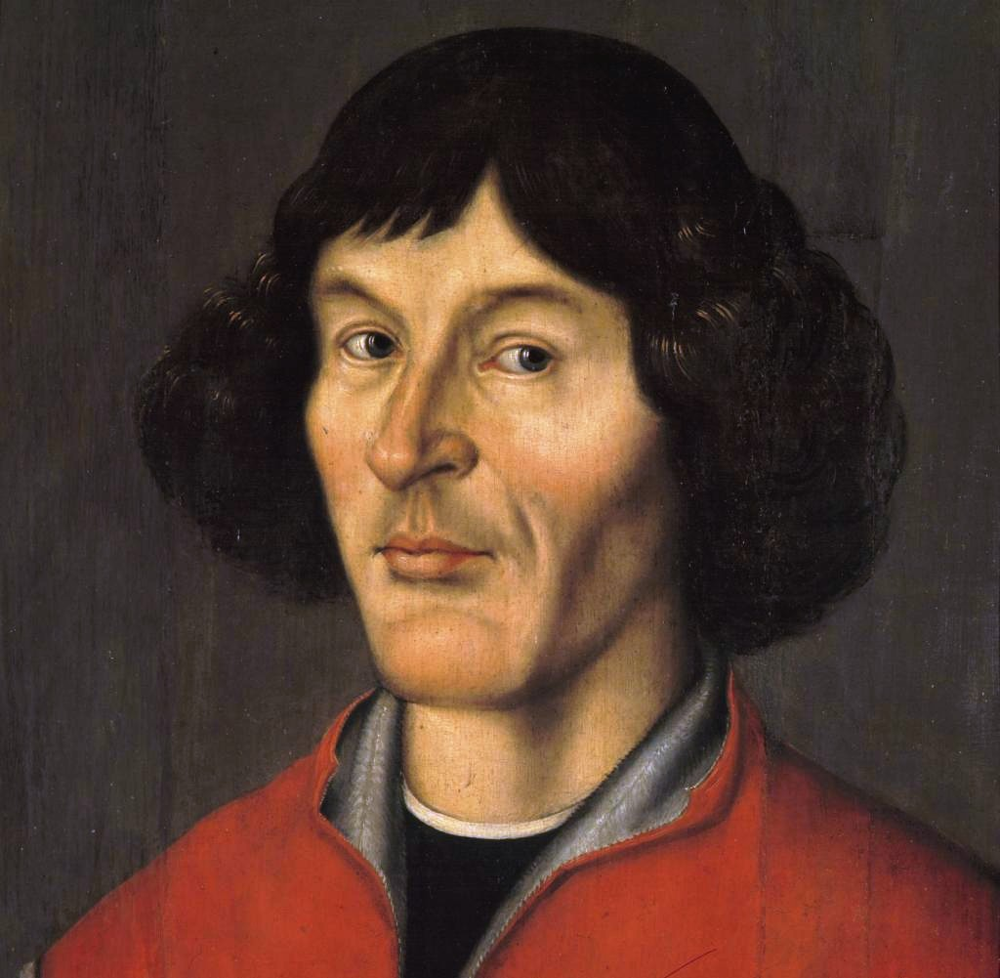
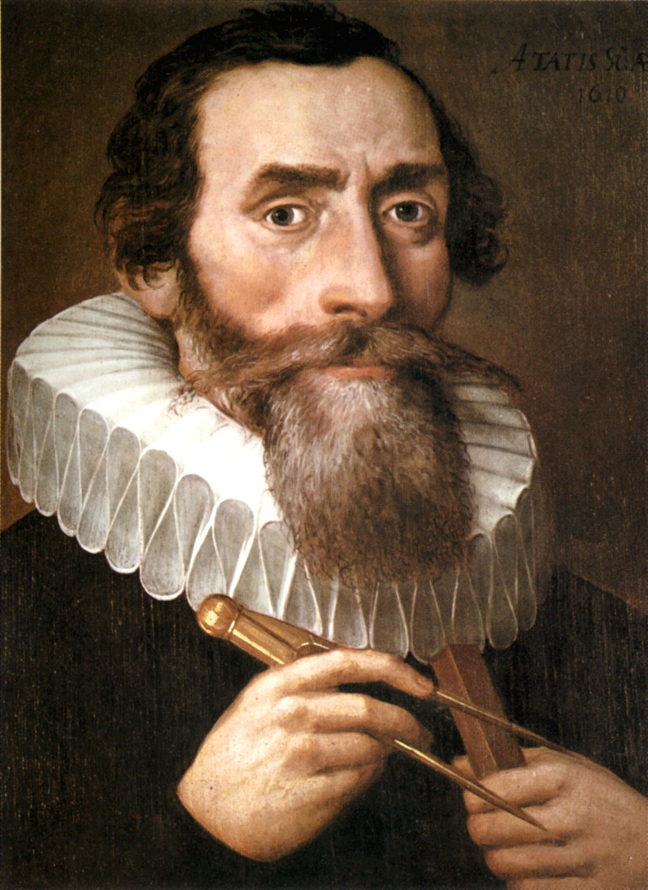
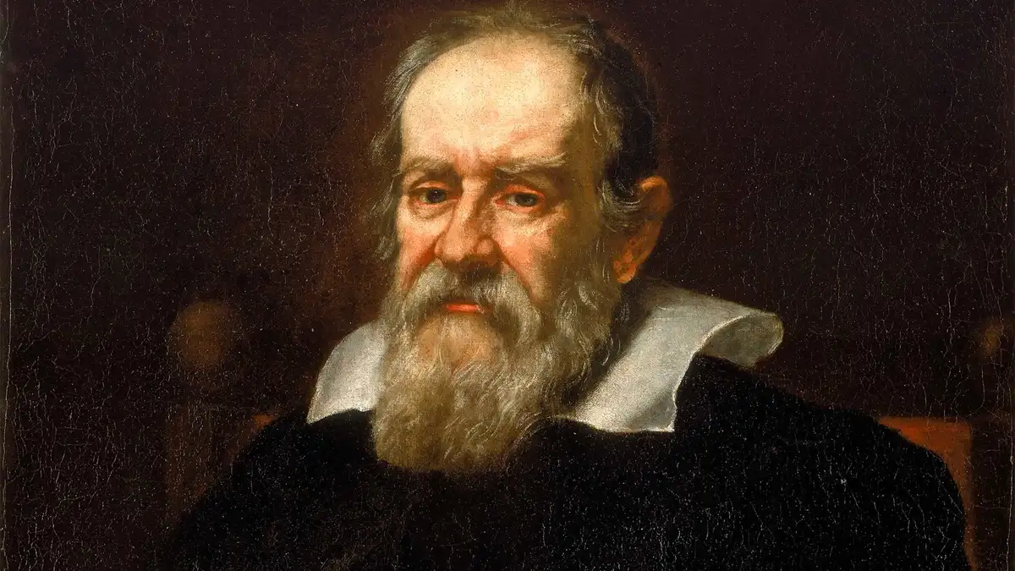
Science Knowledge Organiser
Earth and Space
Year 5
Diagrams and Symbols
Key Vocabulary | Definition
Sun | A huge star that Earth and the other planets in our solar system orbit around.
star | A giant ball of gas held together by its own gravity.
Moon | A natural satellite which orbits Earth or other planets.
planet | A large object, round or nearly round, that orbits a star.
spherical bodies | Astronomical objects shaped like spheres.
satellite | Any object or body in space that orbits something else.
orbit | To move in a regular, repeating curved path around another object.
rotate | To spin. E.g. Earth rotates on its own axis.
axis | An imaginary line that a body rotates around. E.g. Earth’s axis (imaginary line) runs from the North Pole to the South Pole.
geocentric model | A belief people used to have that other planets and the Sun orbited around Earth.
heliocentric model | The structure of the Solar System where the planets orbit around the Sun.
astronomer | Someone who studies or is an expert in astronomy (space science).
The Solar System
What? (Key Knowledge)
Mercury, Venus, Earth and Mars are rocky planets. They are mostly made up of metal and rock. Jupiter, Saturn, Uranus and Neptune are mostly made up of gases (helium and hydrogen) although they do have cores made up of rock and metal.
The Moon orbits Earth in an oval- shaped path while spinning on its axis. At various times in a month, the Moon appears to be different shapes. This is because as the Moon rotates around Earth, the Sun lights up different parts of it.
Earth rotates (spins) on its axis. It does a full rotation once in every 24 hours. At the same time that Earth is rotating, it is also orbiting (revolving) around the Sun. It takes a little more than 365 days to orbit the Sun.
Daytime occurs when the side of Earth is facing towards the Sun. Night occurs when the side of Earth is facing away from the Sun.
The work and ideas of many astronomers (such as Copernicus and Kepler) combined over many years before the idea of the heliocentric model was developed. Galileo’s work on gravity allowed astronomers to understand how planets stayed in orbit.
Phases of The Moon
Key Figures and Scientists
Nicolaus Copernicus
Johannes Kepler
Galileo Galilei

