Slide 1
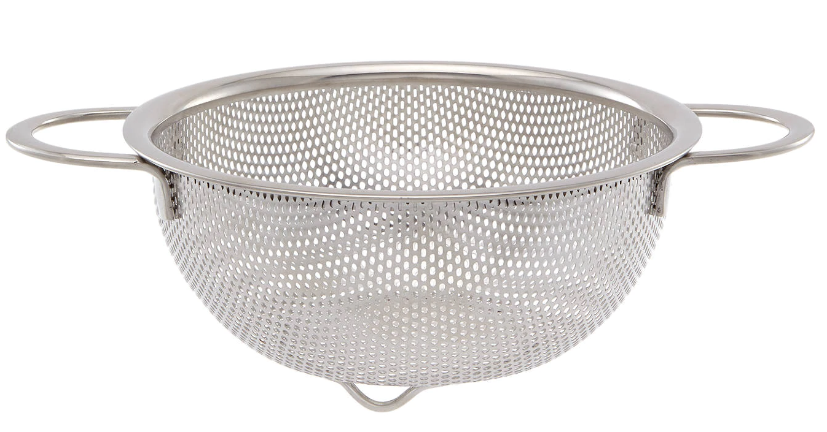
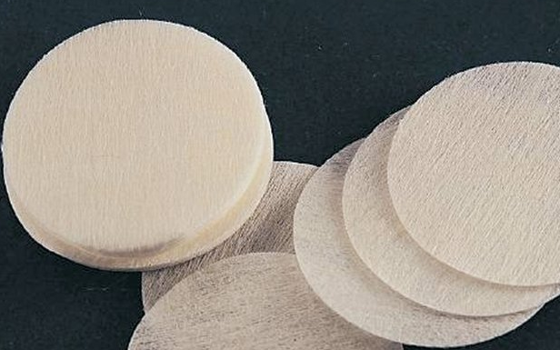
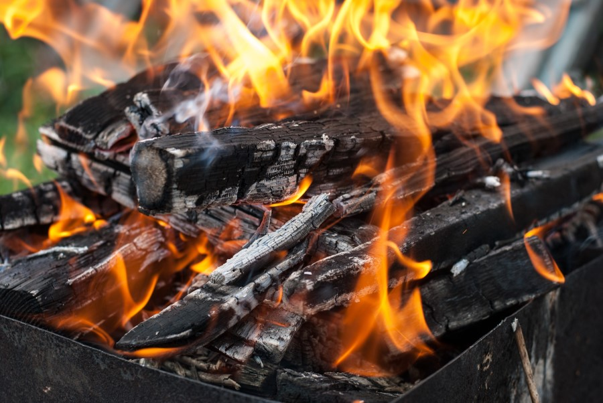



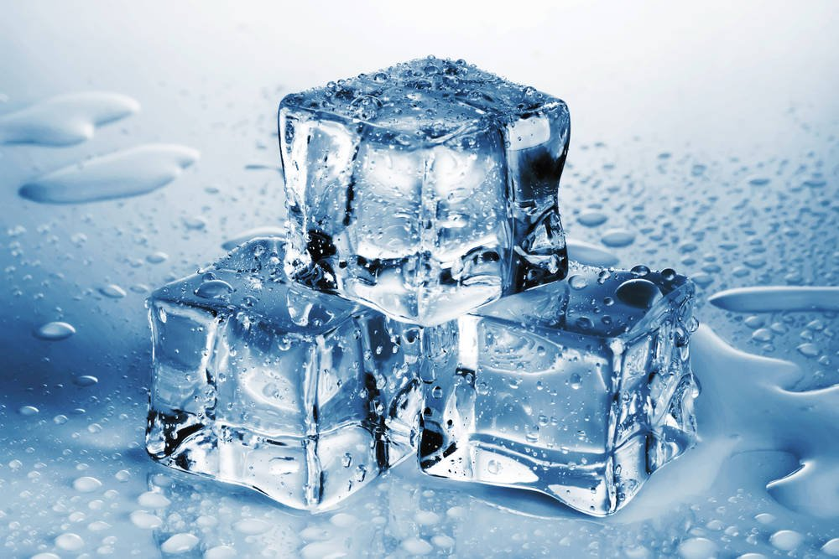
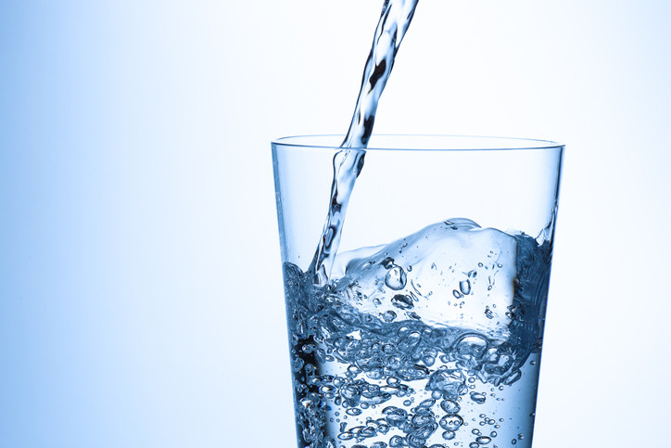
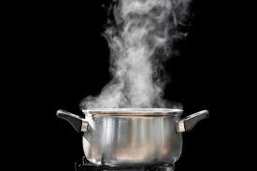
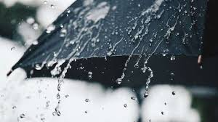
Science Knowledge Organiser
Properties and changes of materials
Year 5
Sieve
Filter Paper
Burning wood – irreversible.
What? Key Knowledge Takeaways
Different materials are used for particular jobs based on their properties: electrical conductivity, flexibility, hardness, insulators, magnetism, solubility, thermal conductivity, transparency.
Particles make everything, they are just arranged differently in different materials. In solids, particles are tightly packed together. In liquids, the particles take the shape of their container. In a gas, particles also take the shape of their container but have more space between each particle.
Dissolving: A solution is made when solid particles are mixed with liquid particles. Materials that will dissolve are known as soluble. Materials that won’t dissolve are known as insoluble. A suspension is when the particles don’t dissolve and are “suspended” in the liquid.
Some changes can’t be reversed once they have taken place. Such as burning wood, dissolving plastic using a vinegar (an acid). We would call this an irreversible change.
Certain changes, such as mixing, dissolving and melting solids and liquids together, can be reversed. We would describe this as a reversible change.
Sieving is a process by which solids can be separated from another solid it has been mixed with. Smaller particles can fall through the sieve whilst larger particles remain in the sieve.
Filtering is a process by which solids can be separated from a liquid it has been mixed with. Liquid will pass through tiny holes in the filter (usually filter paper) and leave the solid on top of the filter.
Evaporating is a process by which solids can be separated from a liquid it has been dissolved in. Heat is applied to the solution causing the liquid to change state into a gas, leaving behind the solid.
Particles in a solid.
Particles in a liquid.
Particles in a gas.
Key Vocabulary | Definition
materials | The substance that something is made out of, e.g. wood, plastic, metal.
solids | One of the three states of matter. Solid particles are very close together, meaning solids, such as wood and glass, hold their shape.
liquids | This state of matter can flow and take the shape of the container because the particles are more loosely packed than solids and can move around each other. Examples of liquids include water and milk.
gases | One of the three states of matter. Gas particles are further apart than solid or liquid particles and they are free to move around. Examples of gases are oxygen and helium.
melting | The process of heating a solid until it changes into a liquid.
freezing | When a liquid cools and turns into a solid.
evaporating | When a liquid turns into a gas or vapour.
condensing | When a gas, such as water vapour, cools and turns into a liquid.
conductor | A conductor is a material that heat or electricity can easily travel through. Most metals are both thermal conductors (they conduct heat) and electrical conductors (they conduct electricity).
insulator | An insulator is a material that does not let heat or electricity travel through them. Wood and plastic are both thermal and electrical insulators.
transparency | A transparent object lets light through so the object can be looked through, for example glass or some plastics.
A reversible change:
Melting
Evaporating
Condensing

