Slide 1

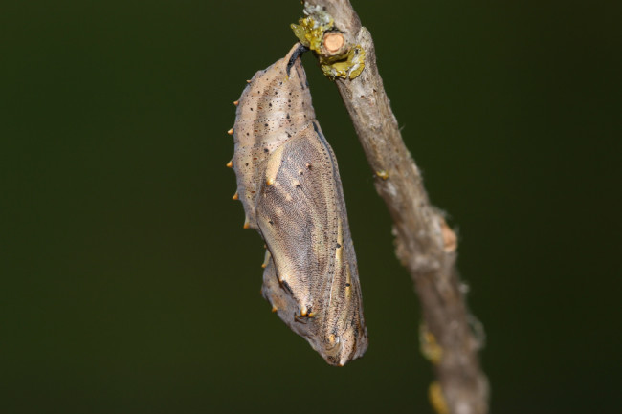
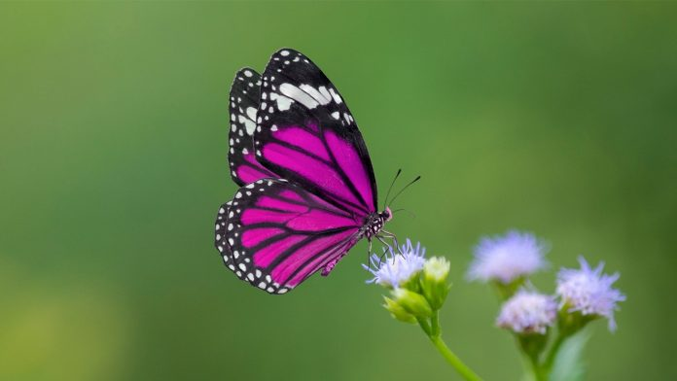
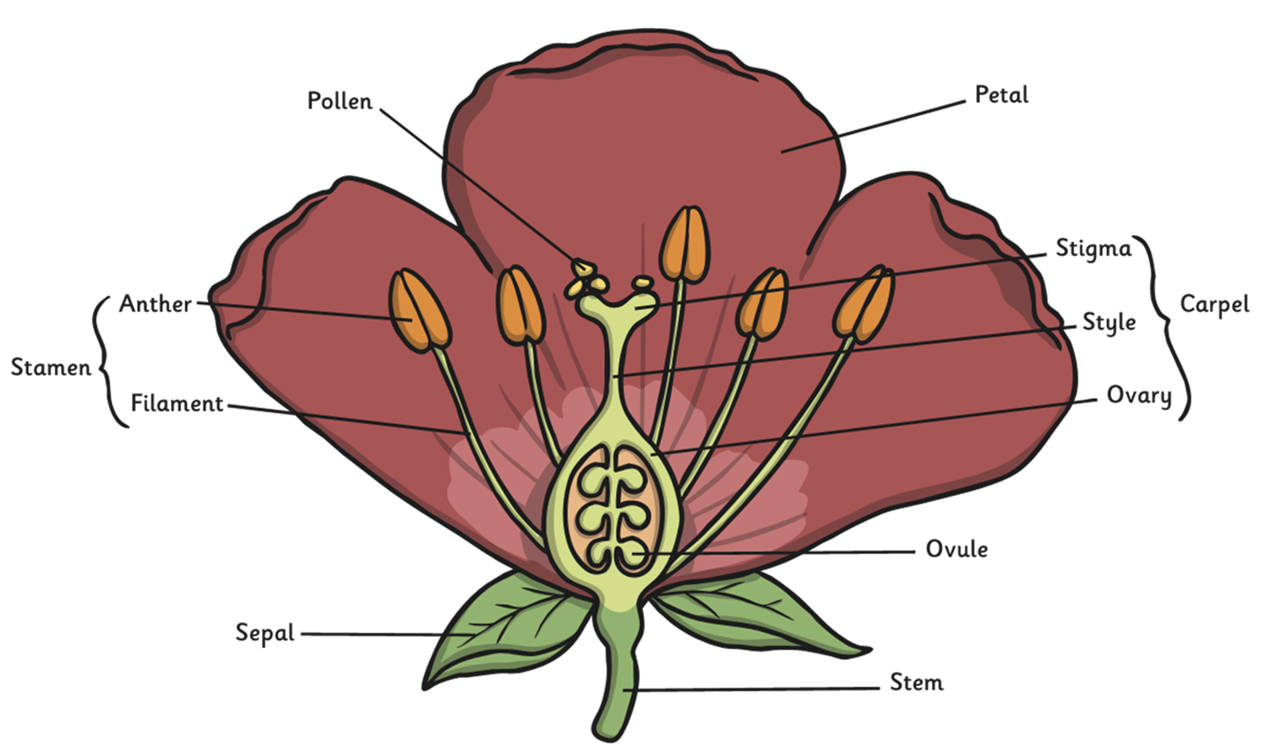
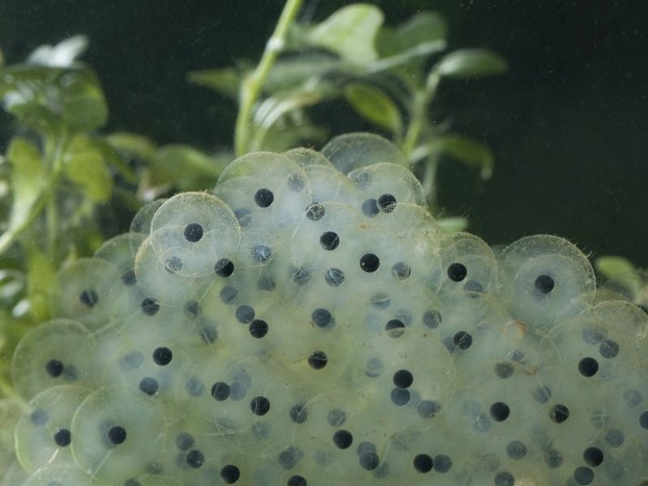
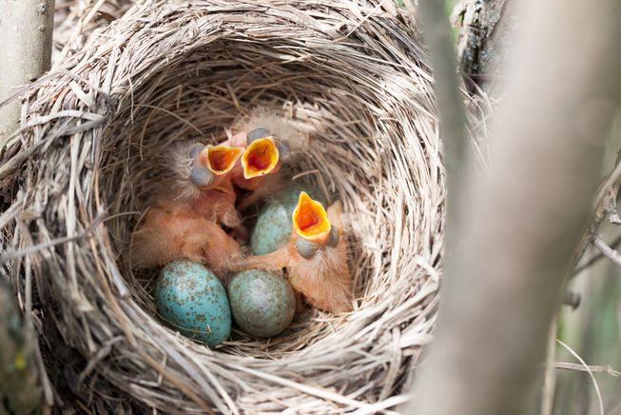
Science Knowledge Organiser
Living things and their habitats
Year 5
Caterpillar ->
Chrysalis ->
Butterfly ->
What? Key Knowledge Takeaways
Humans develop inside their mothers and are dependent on their parents for many years until they are old enough to look after themselves.
Amphibians such as frogs are laid in eggs then, once hatched, go through many changes until they become an adult.
Some animals, such as butterflies, go through metamorphosis to become an adult
Birds are hatched from eggs and are looked after by their parents until they are able to live independently.
Some living things, such as plants, contain both the male and female sex cells called gametes.. In others, such as humans, they contain either the male or female sex cell.
Mammals use sexual reproduction to produce their offspring. •The male sex cell, called the sperm, fertilises the female sex cells. •The fertilised cell divides into different cells and will form a baby with a beating heart. •The baby will grow inside the female until the end of the gestation period when the baby is born.
Most plants contain both the male sex cell (pollen) and female sex cell (ovules), but most plants can’t fertilise themselves. Wind and insects help to transfer pollen to a different plant. The pollen from the stamen of one plant is transferred to the stigma of another. The pollen then travels down a tube through the style and fuses with an ovule.
Some plants, such as strawberry plants, potatoes, spider plants and daffodils use asexual reproduction to create a new plant. They are identical to the parent plant.
Key Vocabulary | Definition
asexual reproduction | One parent is needed to create an offspring, which is an exact copy of the parent.
fertilise | The action of fusing the male and female sex cells in order to develop an egg.
gestation | The length of a pregnancy.
life cycle | The journey of changes that take place throughout the life of a living thing including birth, growing up and reproduction.
metamorphosis | An abrupt and obvious change in the structure of an animal’s body and their behaviour.
pollination | The transfer of pollen to a stigma to allow fertilisation.
reproduction | The process of new living things being made.
sexual reproduction | Two parents are needed to make offspring which are similar but not identical to either parent.
eggs | Birds, reptiles and some mammals give birth to eggs which continue to gestate, outside the body.
Anatomy of a flowering plant.
Chicks hatched from bird eggs
Frogspawn (eggs laid by a frog)

