Slide 1
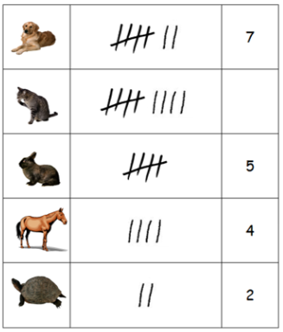
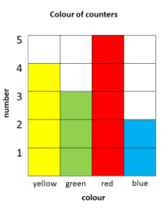
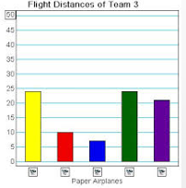
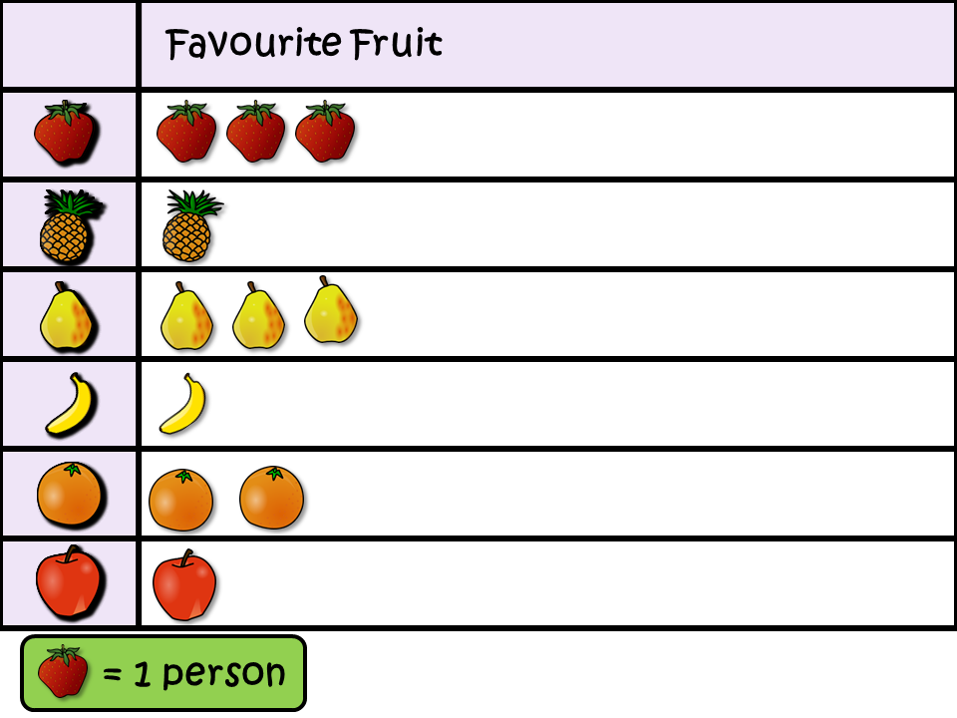
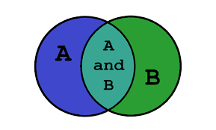
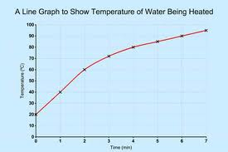
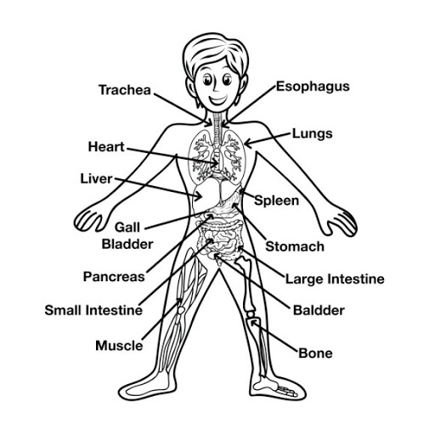
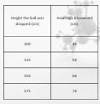


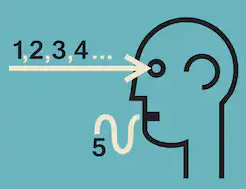
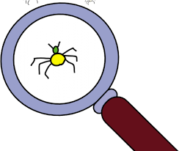



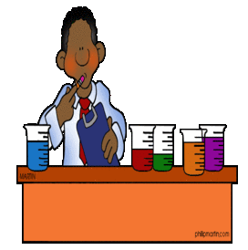




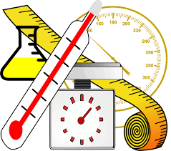

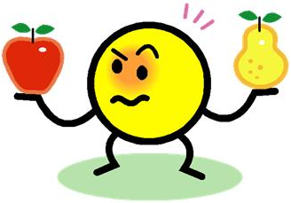
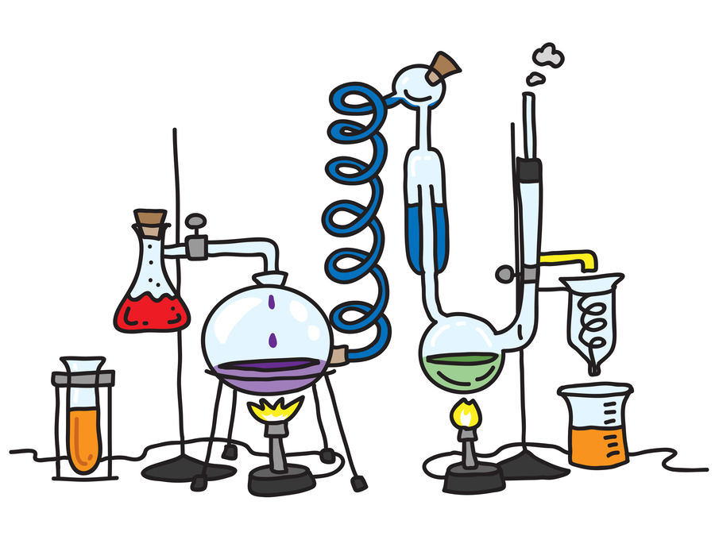





Science Knowledge Organiser
Working Scientifically
Year 4
Recording Data
Simple line graph
Block graph
Bar chart
Pictogram.
Sorting diagram.
Planning and Communication and Sources
Enquiring and Testing and Obtaining and Presenting Evidence
Tables.
Labelled diagram.
Observe and record using:
Begin to know that scientific ideas are based on evidence.
Key Vocabulary | Definition
data | Information that has been collected.
experiment | A carefully planned test used to discover something unknown.
graph | A drawing that shows information with lines, shapes or colours. Sometimes called charts.
evidence | Information that shows something to be true.
factor | Something that contributes to a result.
vary | To make a change to something.
outcome | The final product or end result.
result | What happens at the end of an experiment.
conclusion | Things that can be worked out from the results of an experiment.
Use graphs to find patterns in data.
Show how to vary one factor while others stay the same.
tables
bar charts
Form a simple graph.
Decide on an investigation to answer a question.
Select information from different sources provided.
Explain which factors to vary and which to keep the same.
Observing and Recording
Considering Evidence and Evaluating
Carry out experiments, measuring accurately.
vs
Predict outcomes using previous experience.
Compare predictions with results.
+
Make a series of observations, comparisons and measurements that fit the task.
Select and use suitable equipment.
Relate conclusions to scientific knowledge and understanding.
Suggest improvements and give reasons.

