Slide 1
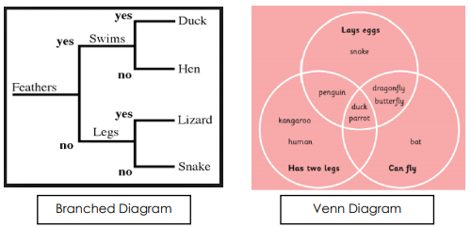
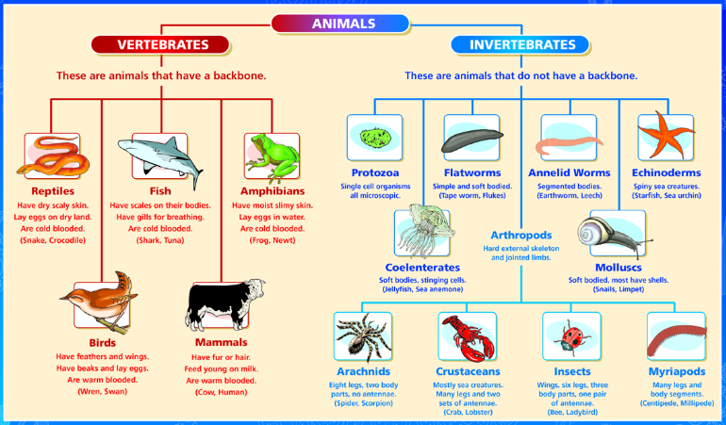
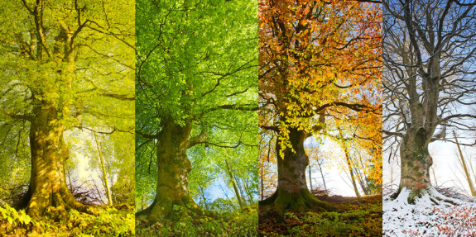
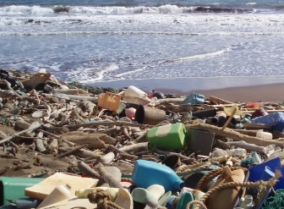
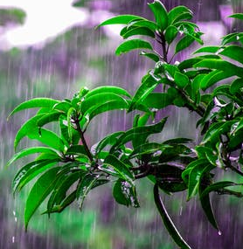
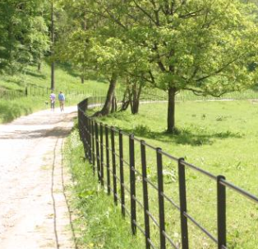
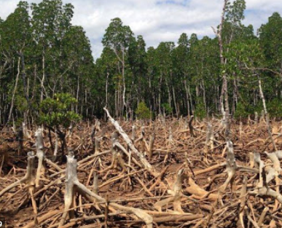
Science Knowledge Organiser
Living things and their habitats
Year 4
Diagrams and Symbols
Key Vocabulary | Definition
organism | An individual living thing, such as a plant, an animal, or a bacteria.
classifying | To put into groups according to things that are similar.
vertebrate | Having a backbone.
invertebrate | Without a backbone.
ecosystem | A community of living things, together with their environment.
habitat | The natural environment of an animal or plant.
unique | Being the only one of its type.
flowering plant | Produces a flower.
non-flowering plant | Does not produce a flower.
Ways of Classifying
What? (Key Knowledge)
The billions of different kinds of living things (organisms) on earth have been divided up, by scientists, into groups according to their similarities and differences. This is known as classifying.
Classifying living things into groups allows scientists to learn more about what makes each species unique.
There are many different classes of animal. Those with backbones are known as vertebrates. These are then grouped into mammals, birds, fish, reptiles and amphibians.
Invertebrates, animals without backbones, are arachnids, insects, snails and slugs and worms.
A habitat is the non-living environment surrounding a living thing. It provides space, shelter, food and water.
An ecosystem is made up of the living organism and the non living habitat. An ecosystem can be any size from a tree to the whole world.
Plants can be classified into two groups- flowering plants (including grasses and some trees) and non flowering plants (conifers, ferns and mosses)
Changing Environments
Natural
Human
litter
seasons
parkland
deforestation
rainfall

