Slide 1
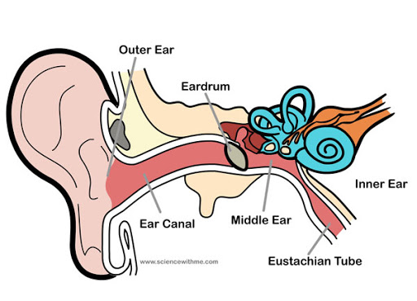
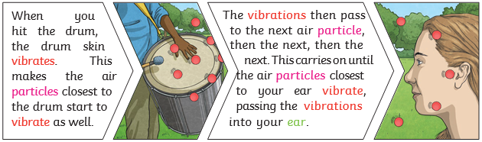
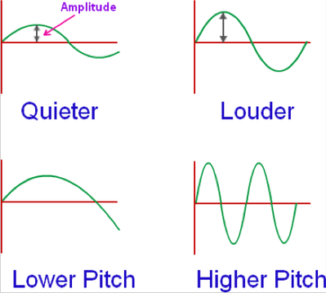
Science Knowledge Organiser
Sound
Year 4
Diagrams and Symbols
Key Vocabulary | Definition
vibration | A movement backwards and forwards.
sound wave | Vibrations travelling from a sound source.
volume | The loudness of a sound.
amplitude | The size of a vibration. A larger amplitude = a louder sound.
pitch | How low or high a sound is.
ear | An organ used for hearing.
particles | Solids, liquids and gases are made of particles. They are so small we are unable to see them.
soundproof | To prevent sound from passing.
vacuum | A space where there is nothing. There are no particles in a vacuum.
eardrum | A part of the ear which is a thin, tough layer of tissue that is stretched out like a drum skin. It separates the outer ear from the middle and inner ear. Sound waves make the eardrum vibrate.
The Human Ear
What? (Key Knowledge)
Sound is a type of energy. Sounds are created by vibrations. The louder the sound, the bigger the vibration.
Pitch is a measure of how high or low a sound is. A whistle being blown creates a high-pitched sound. A rumble of thunder is an example of a low-pitched sound. | Faster vibrations = higher pitch
 | Slower vibrations = lower pitch
Sound can travel through solids, liquids and gases. Sound travels as a wave, vibrating the particles in the medium it is travelling in. Sound cannot travel through a vacuum.
Sound energy can travel from particle to particle far easier in a solid because the vibrating particles are closer together than in other states of matter.
Inside your ear, the vibrations hit the eardrum and are then passed to the middle and then the inner ear. They are then changed into electrical signals and sent to your brain. Your brain tells you that you are hearing a sound.
Sound Waves

